Slide 1
https://dev.mysql.com/downloads/installer/

Slide 2
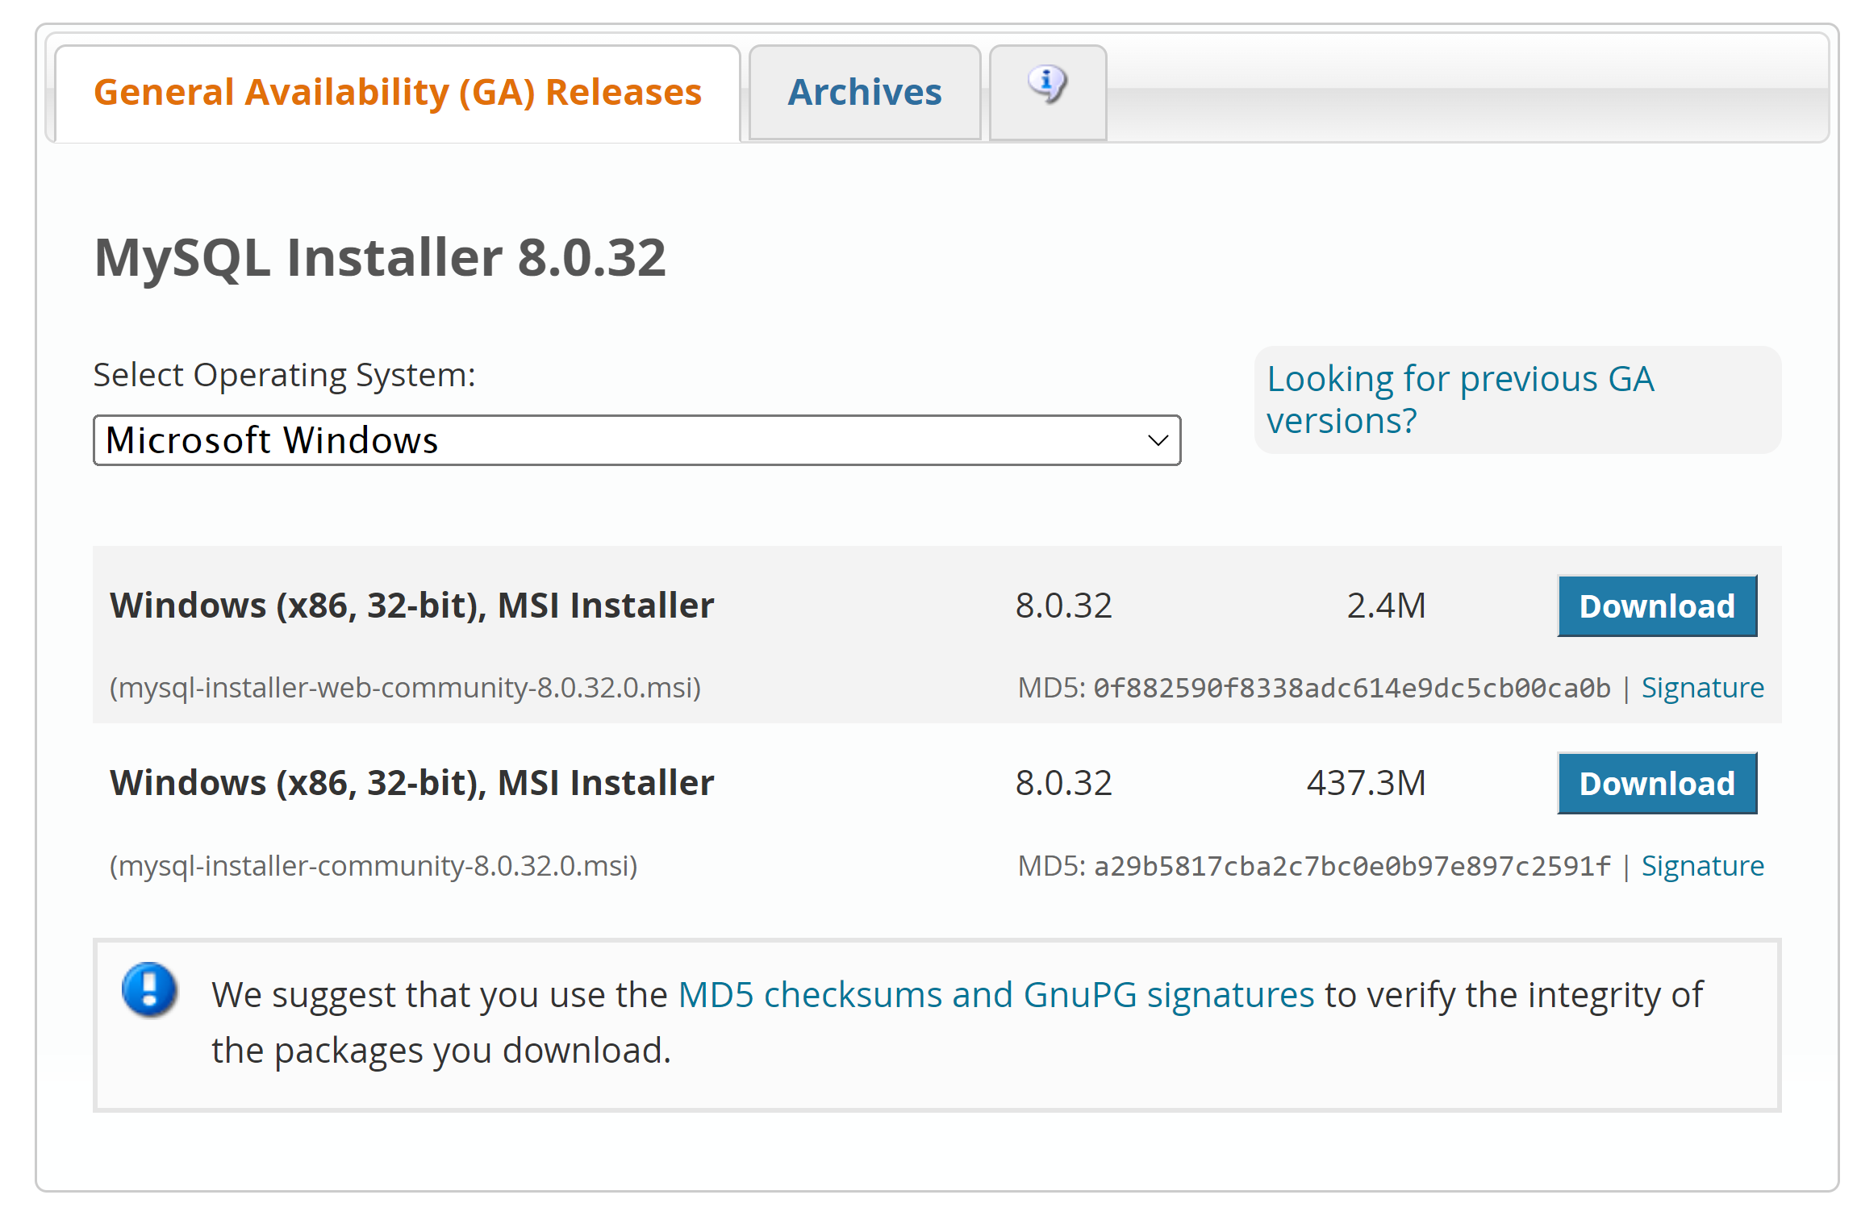
https://dev.mysql.com/downloads/installer/

Slide 3
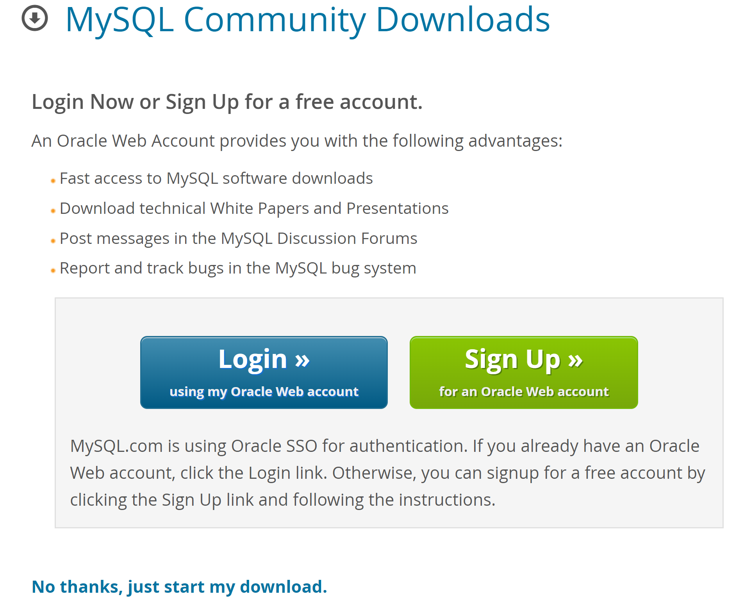

Slide 4

Installing MySQL Server:
mysql-installer-community-8.0.32.0

Slide 5


Slide 6


Slide 7


Slide 8


Slide 9


Slide 10
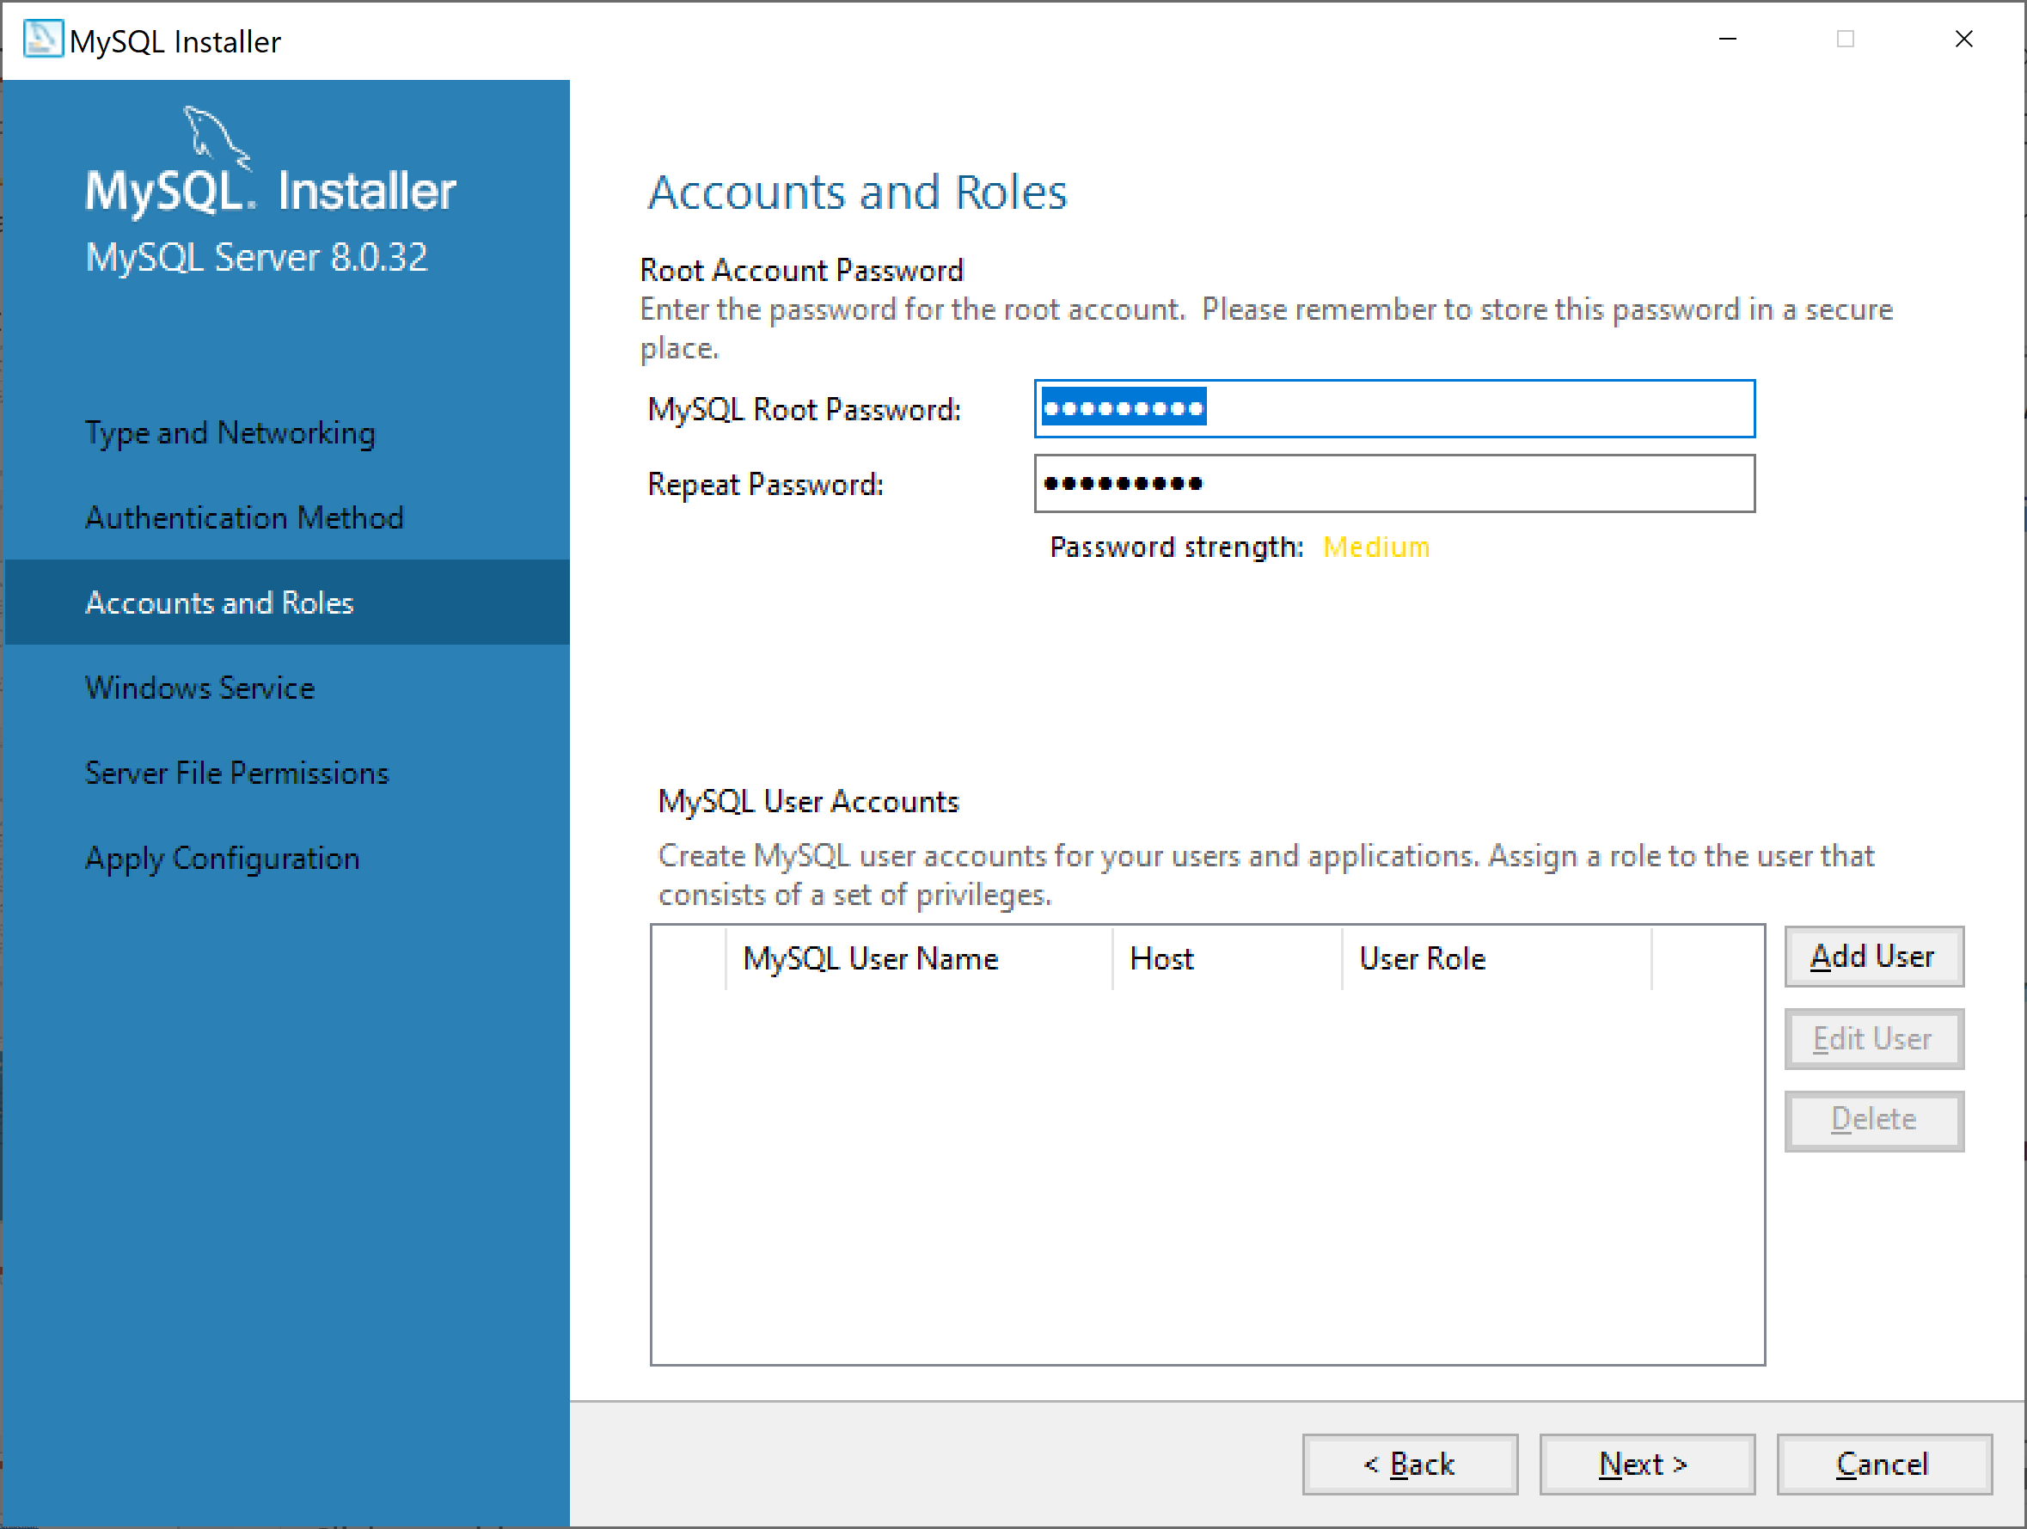
Root account:
root
Password:
@Obama123

Slide 11
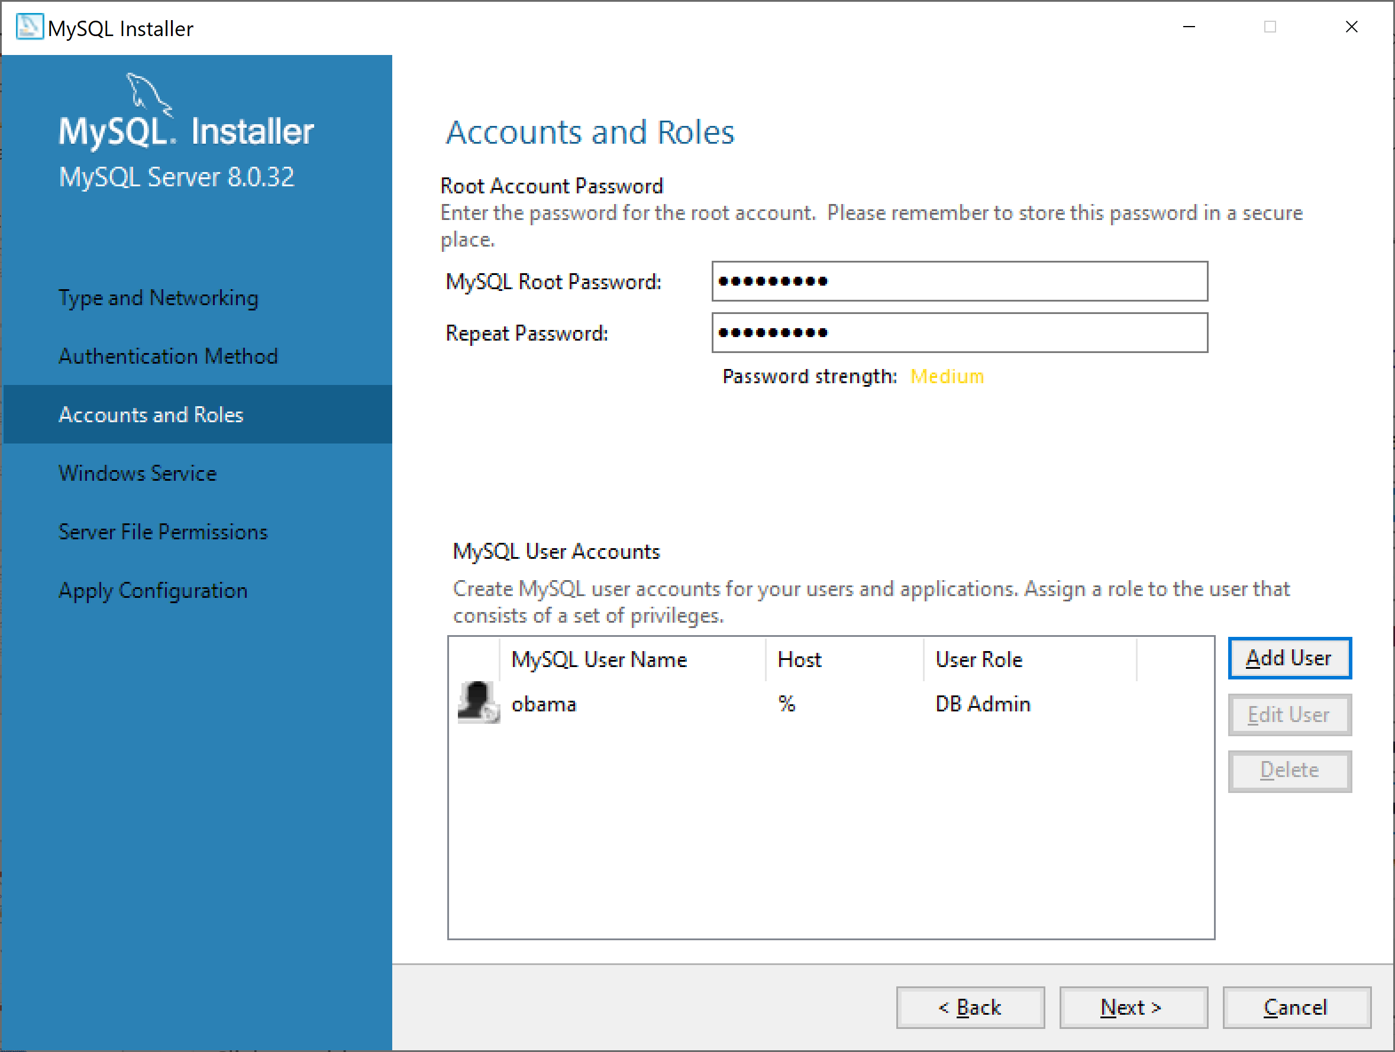
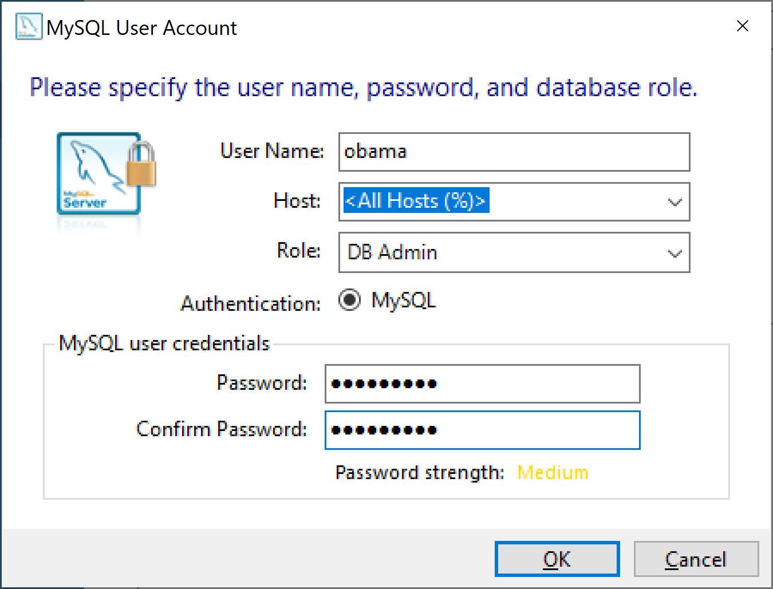
username
obama
Password:
@Obama123

Slide 12


Slide 13
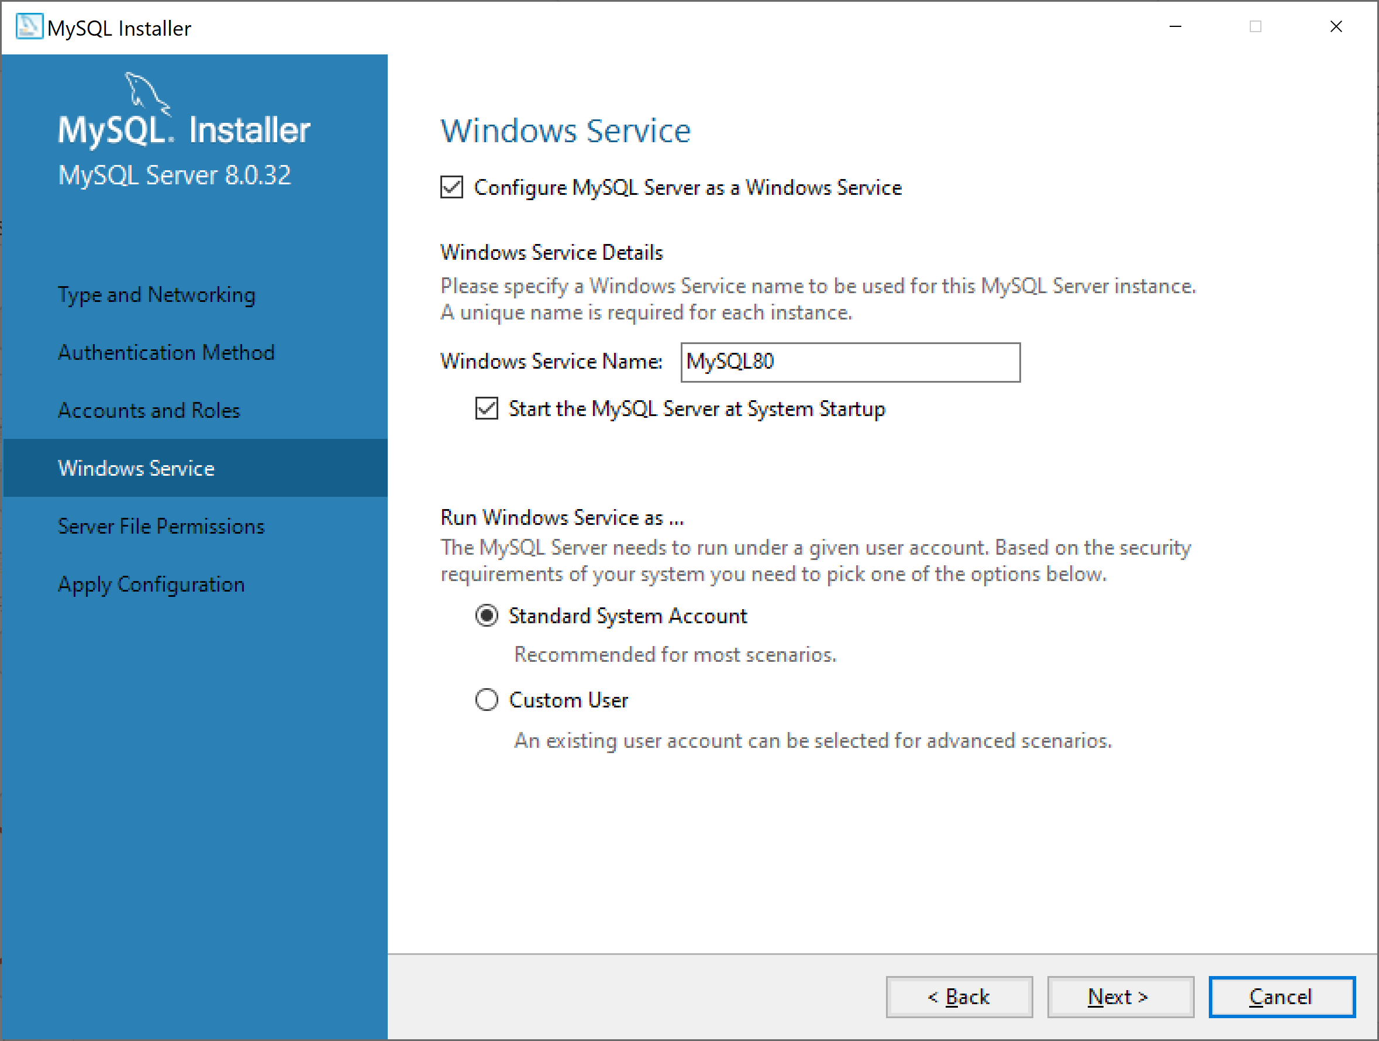

Slide 14


Slide 15


Slide 16


Slide 17


Slide 18


Slide 19


Slide 20


Slide 21


Slide 22
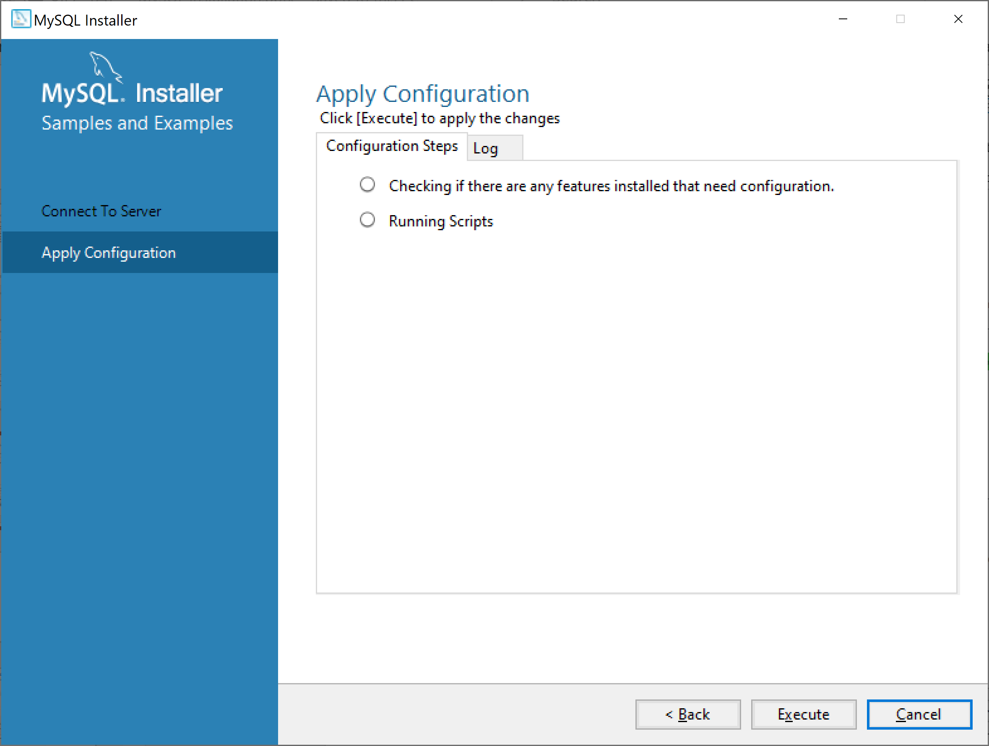

Slide 23
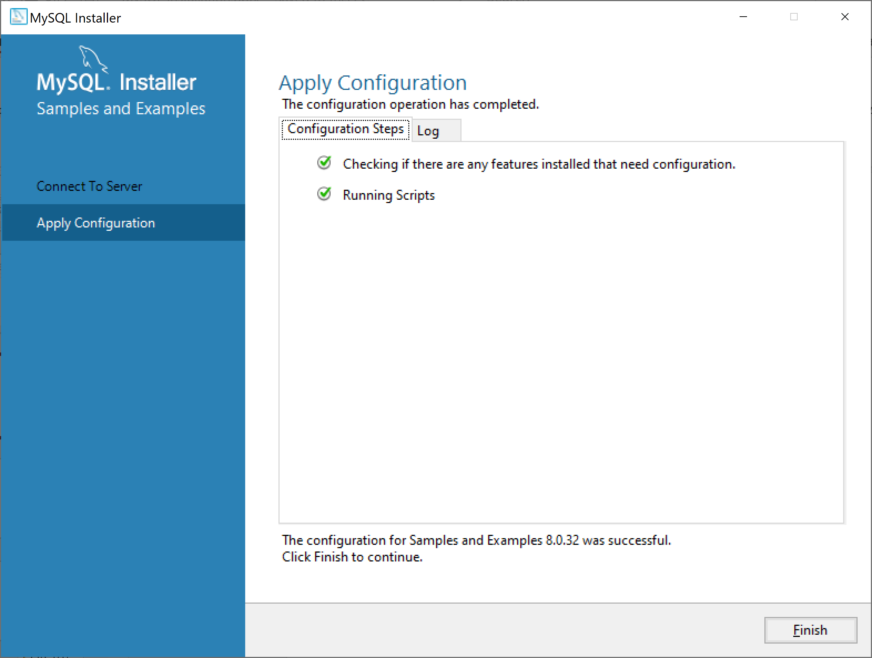

Slide 24


Slide 25


Slide 26
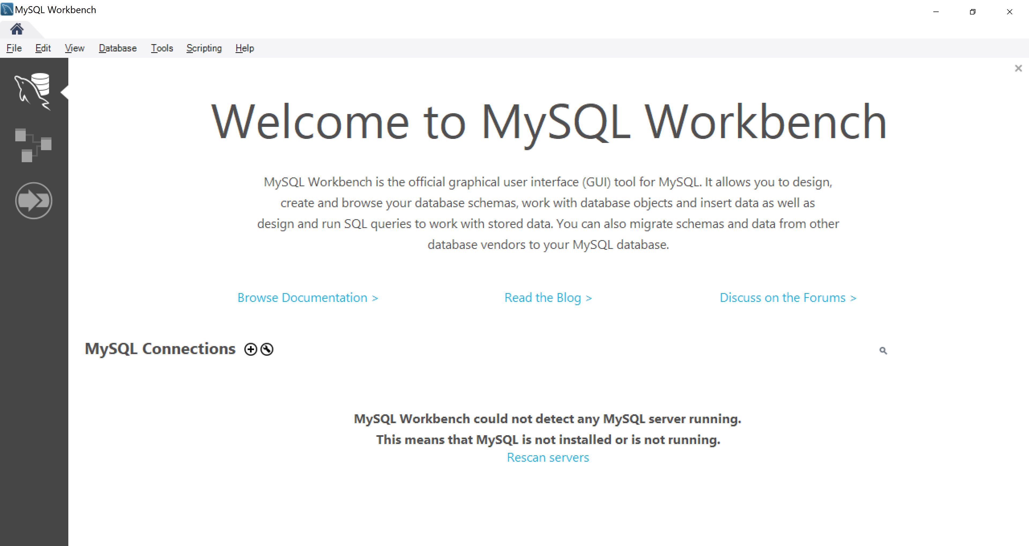

Slide 27
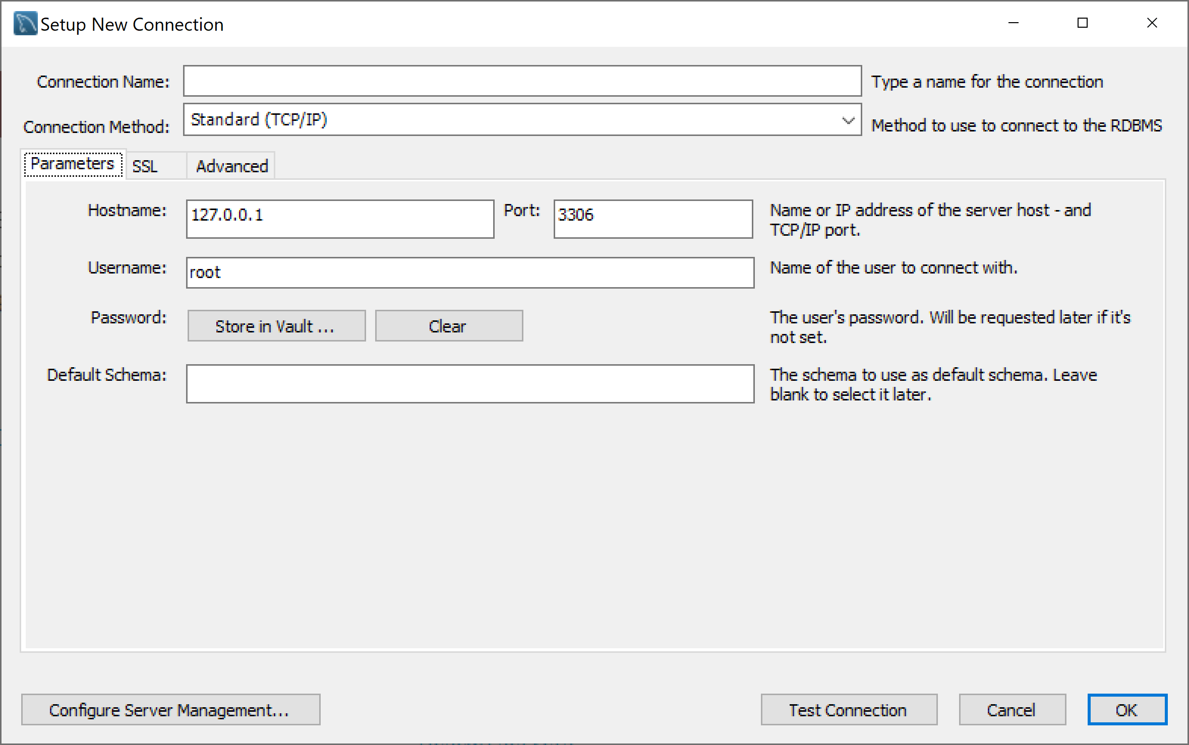

Slide 28
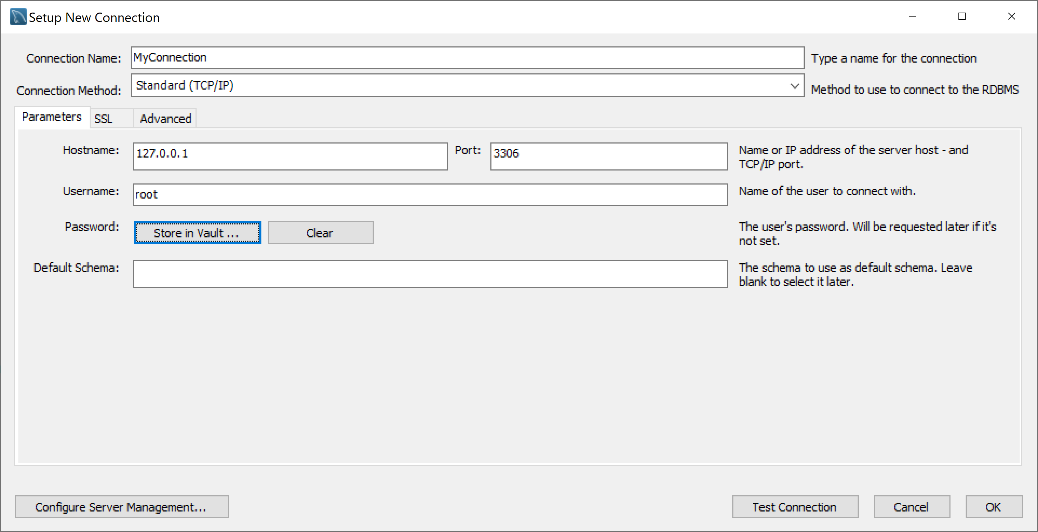

Slide 29
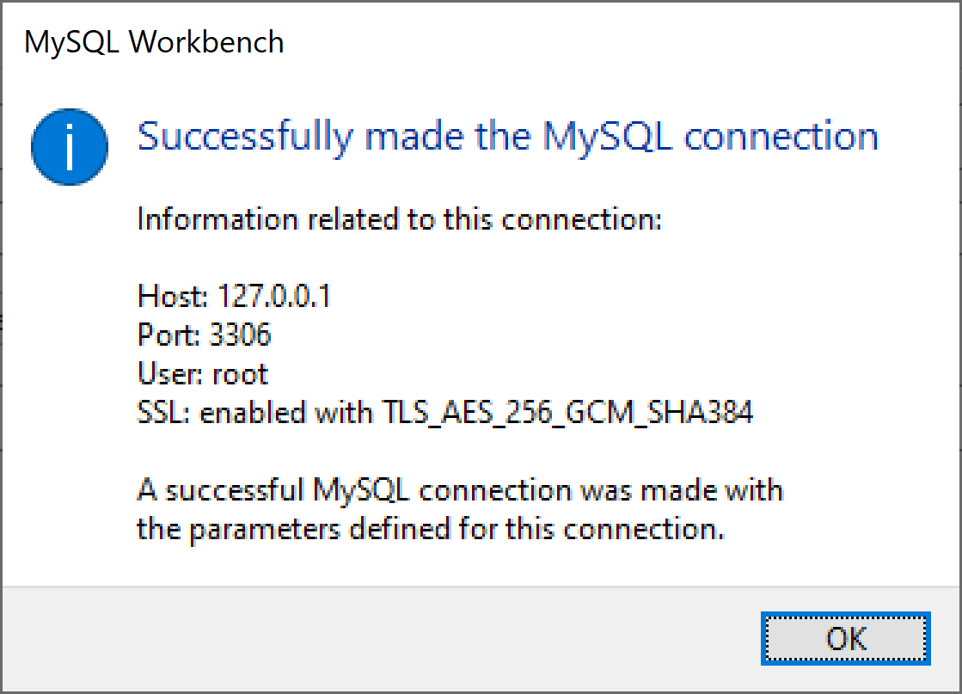
Click test connection

Slide 30
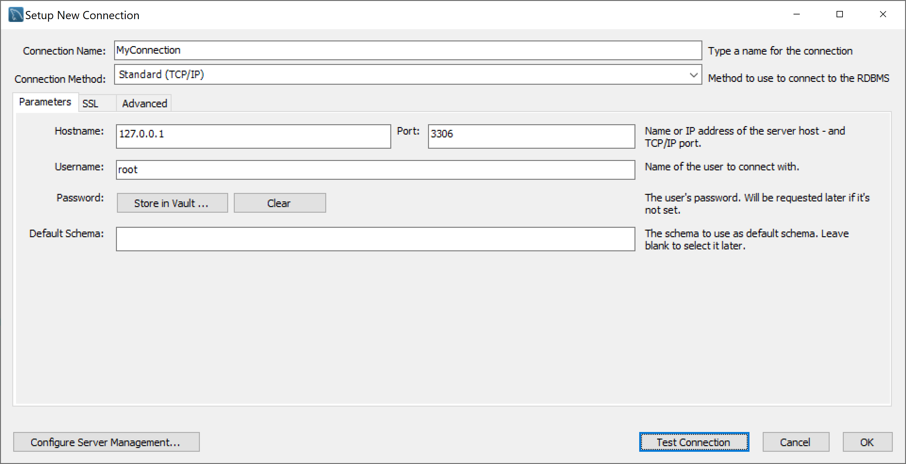

Slide 31
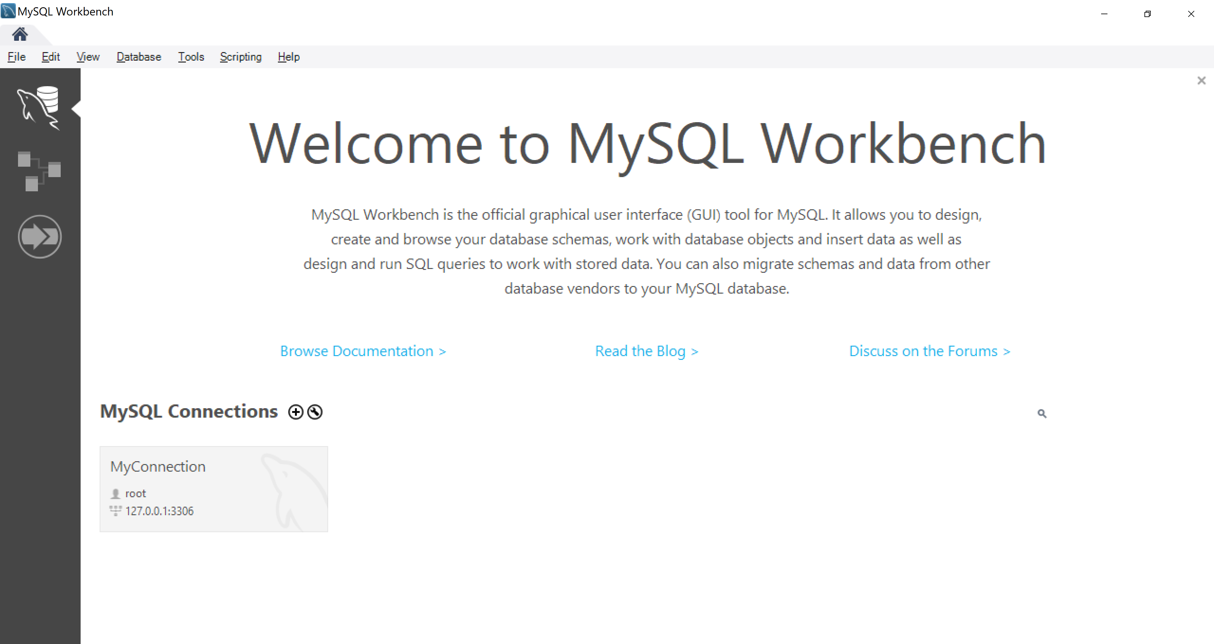

Slide 32
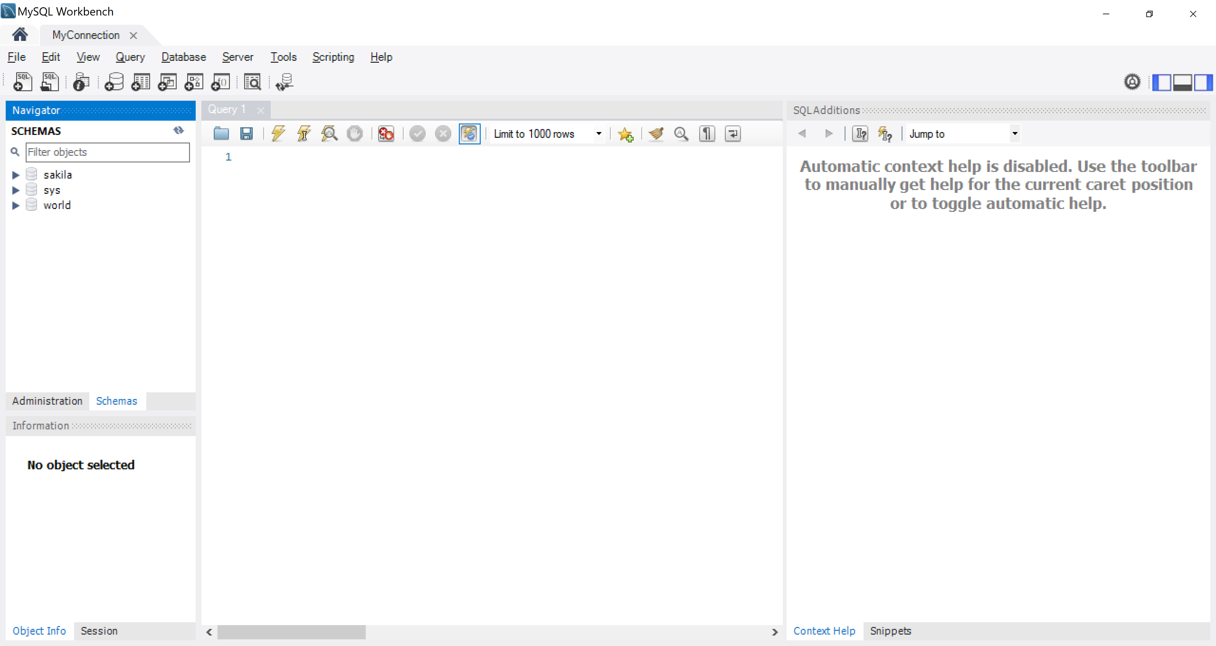

Slide 33
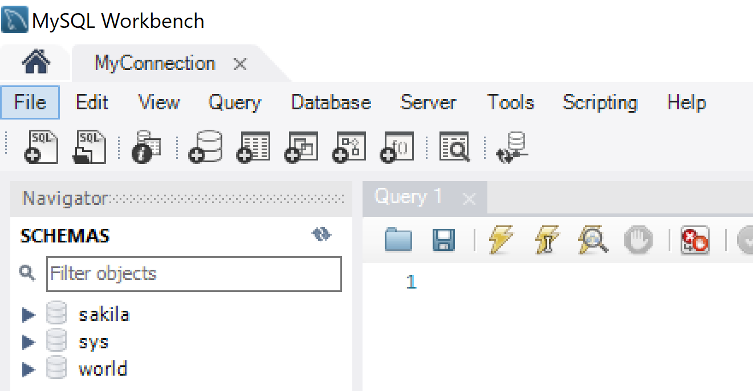

Slide 34
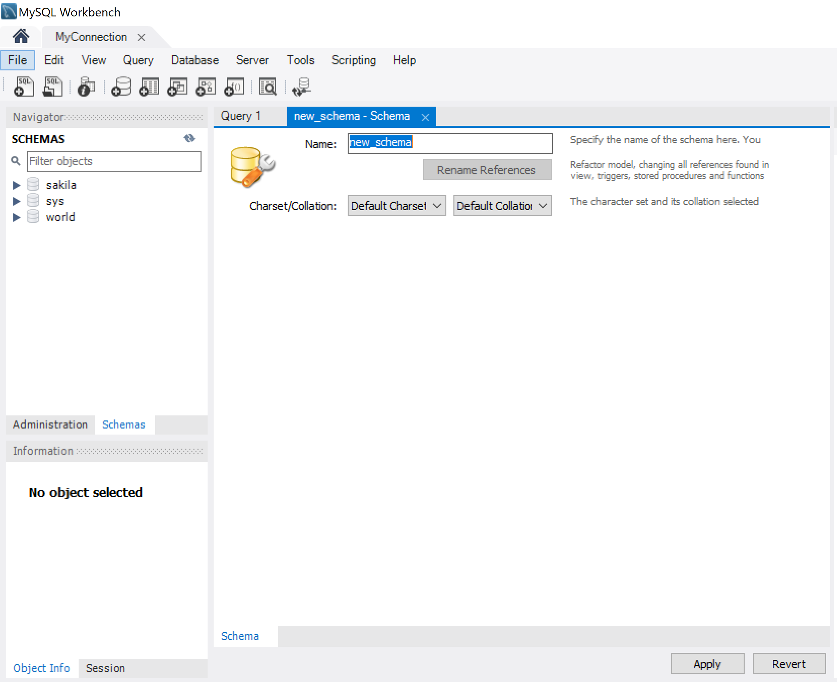
New Schema

Slide 35
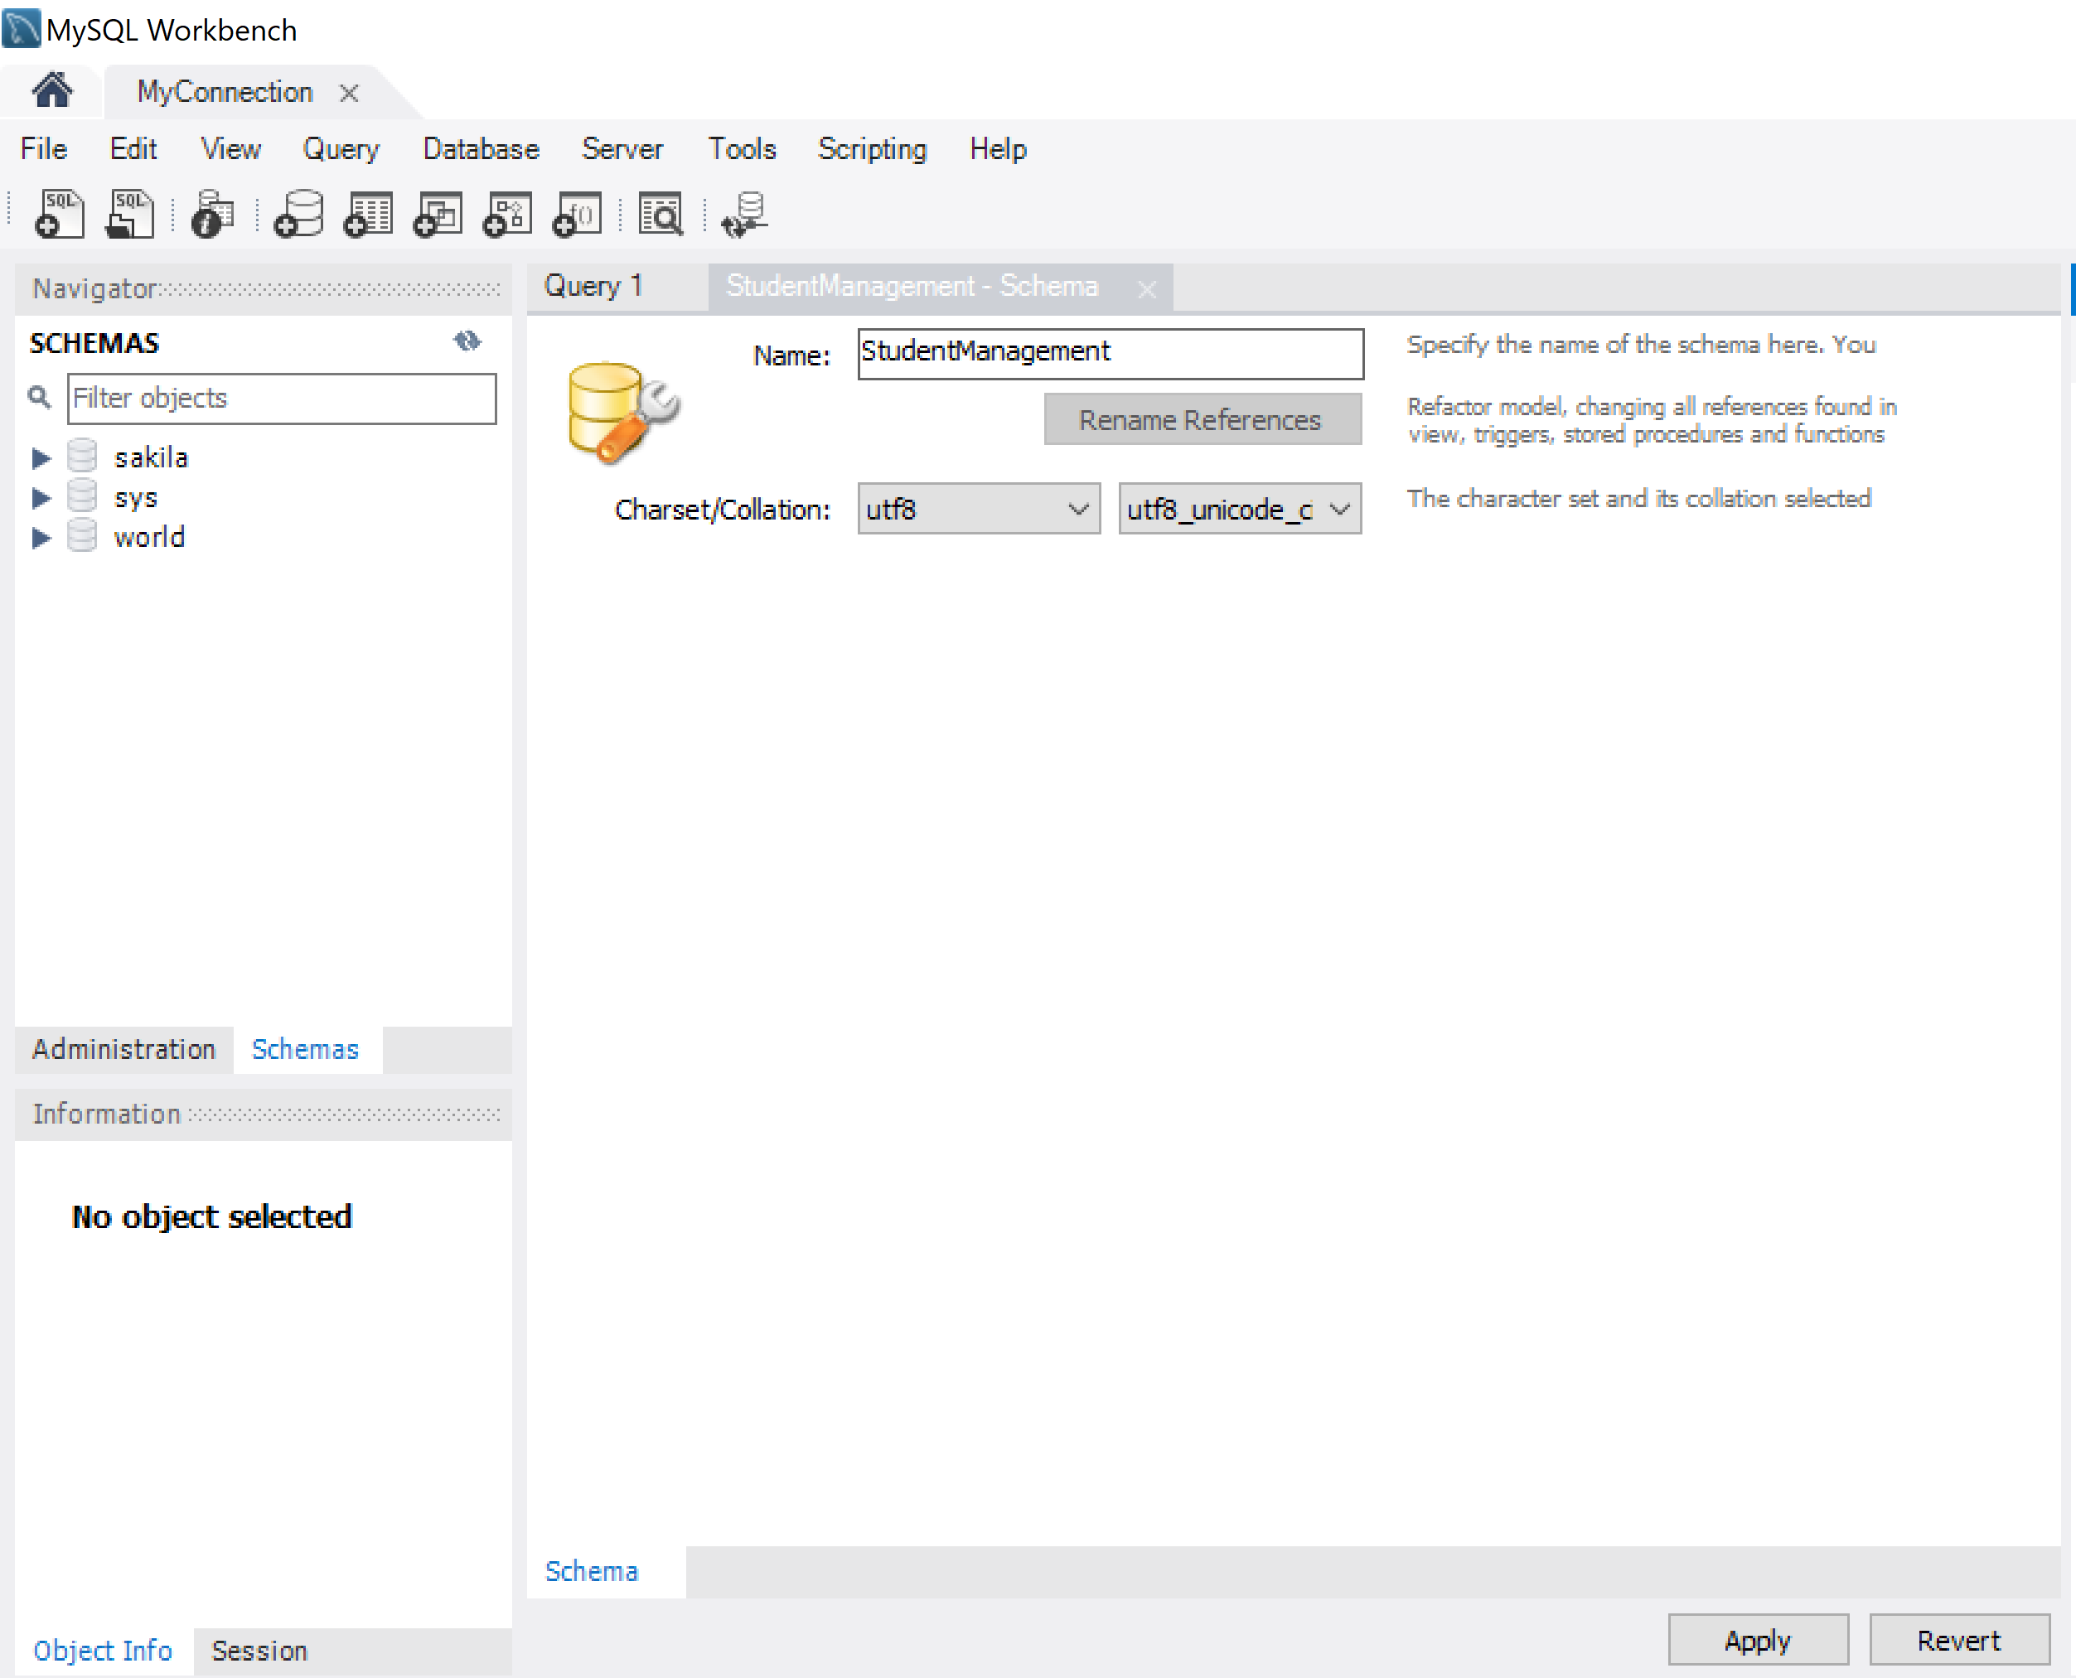

Slide 36
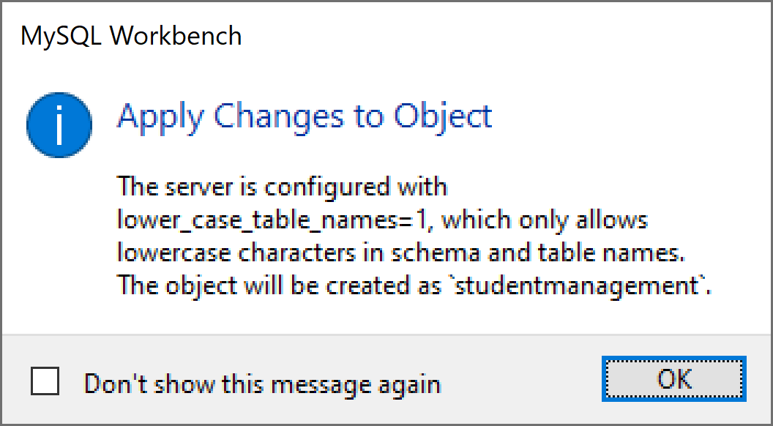

Slide 37
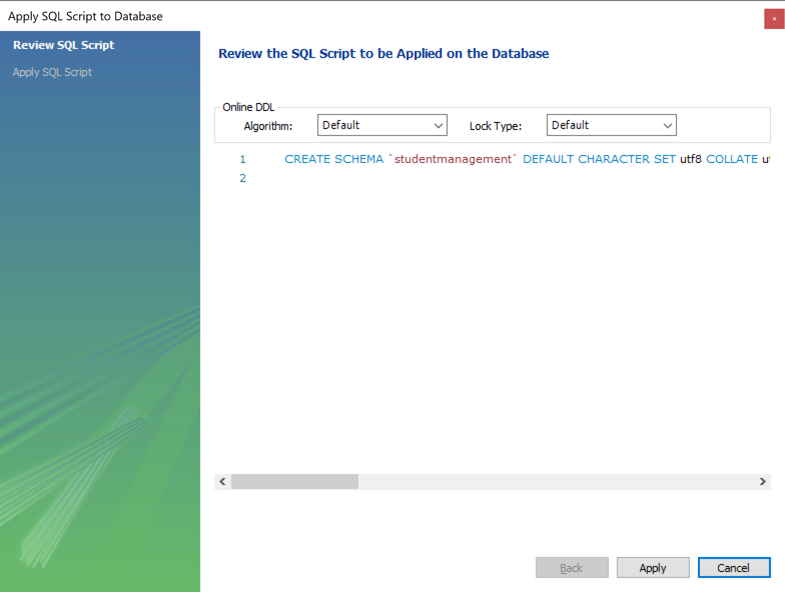

Slide 38
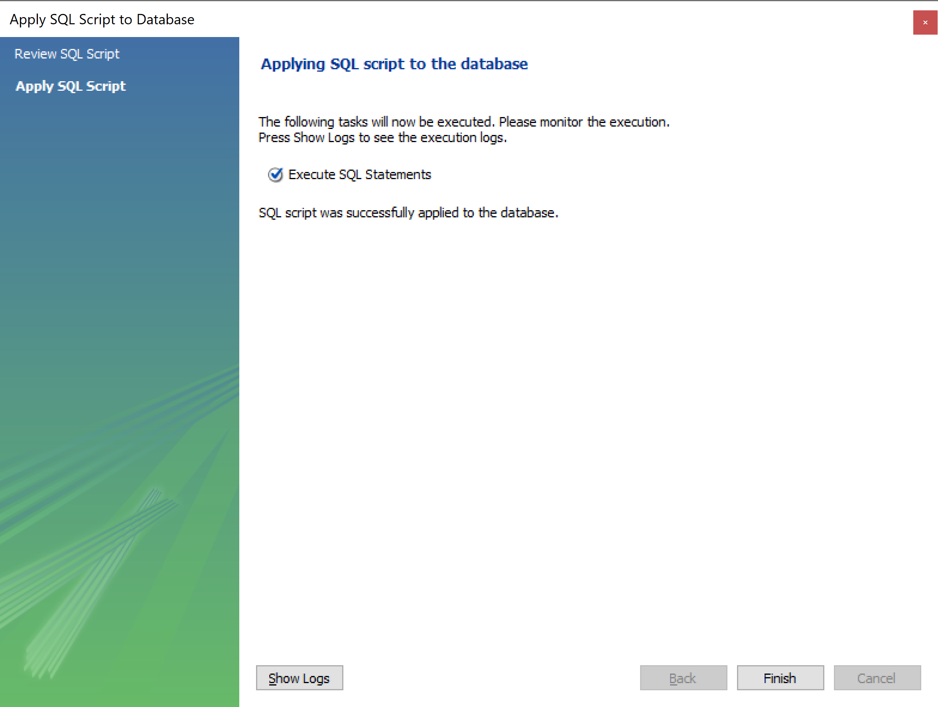

Slide 39
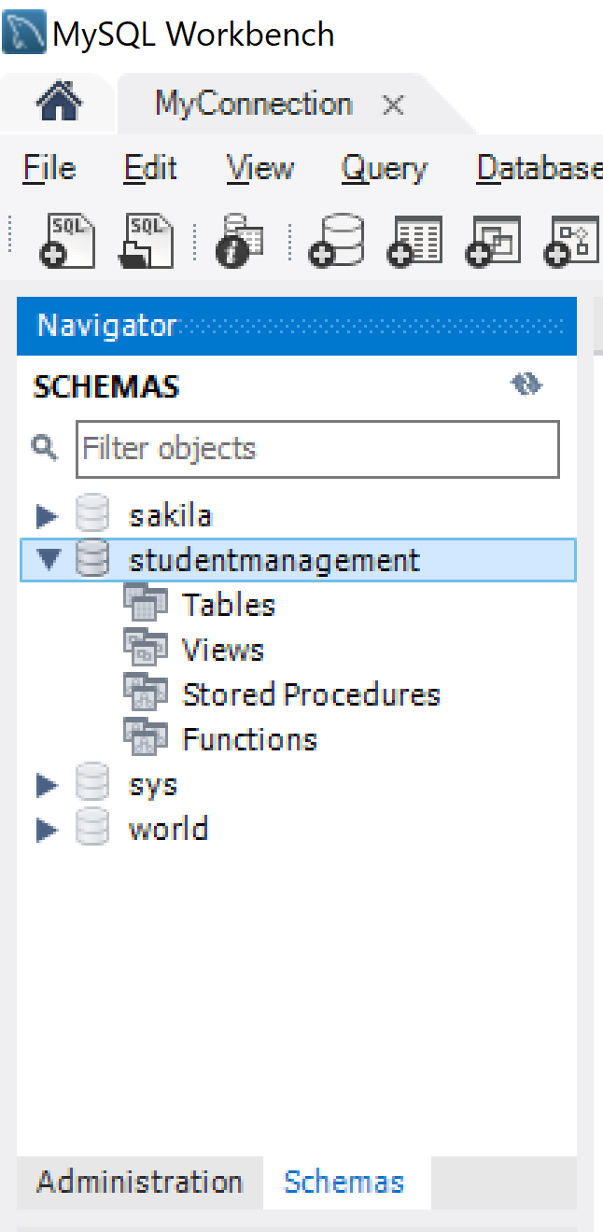

Slide 40
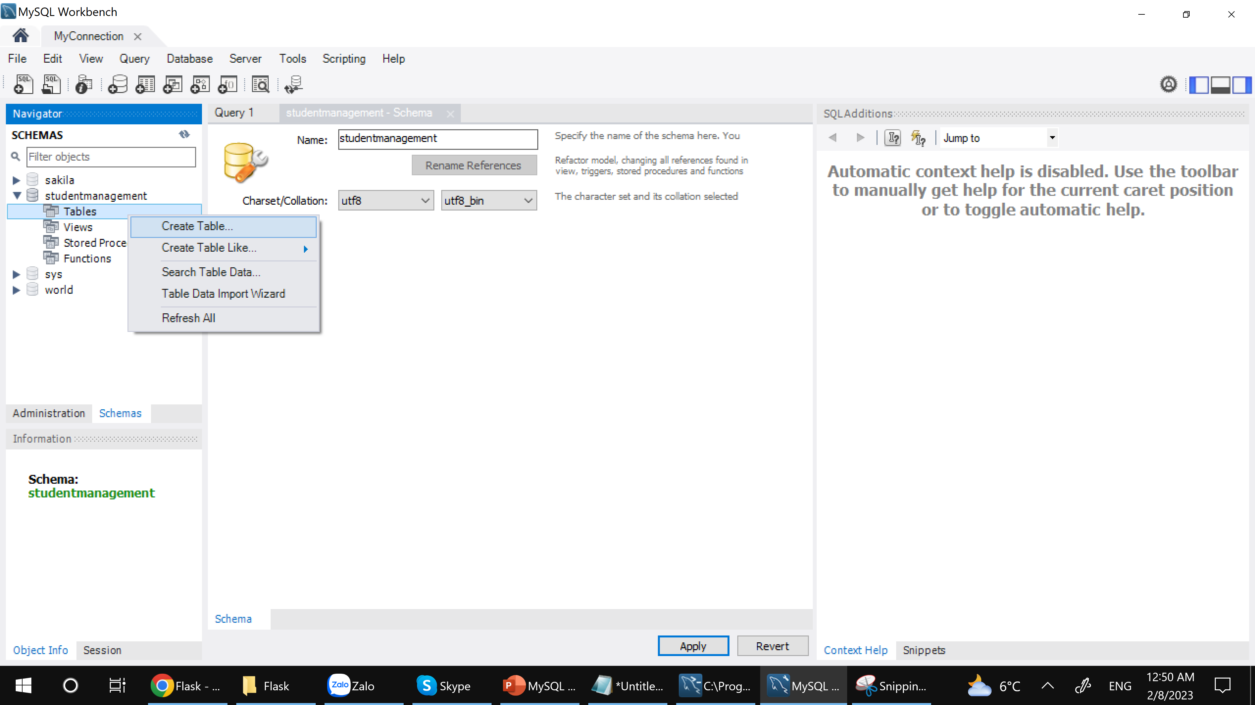

Slide 41
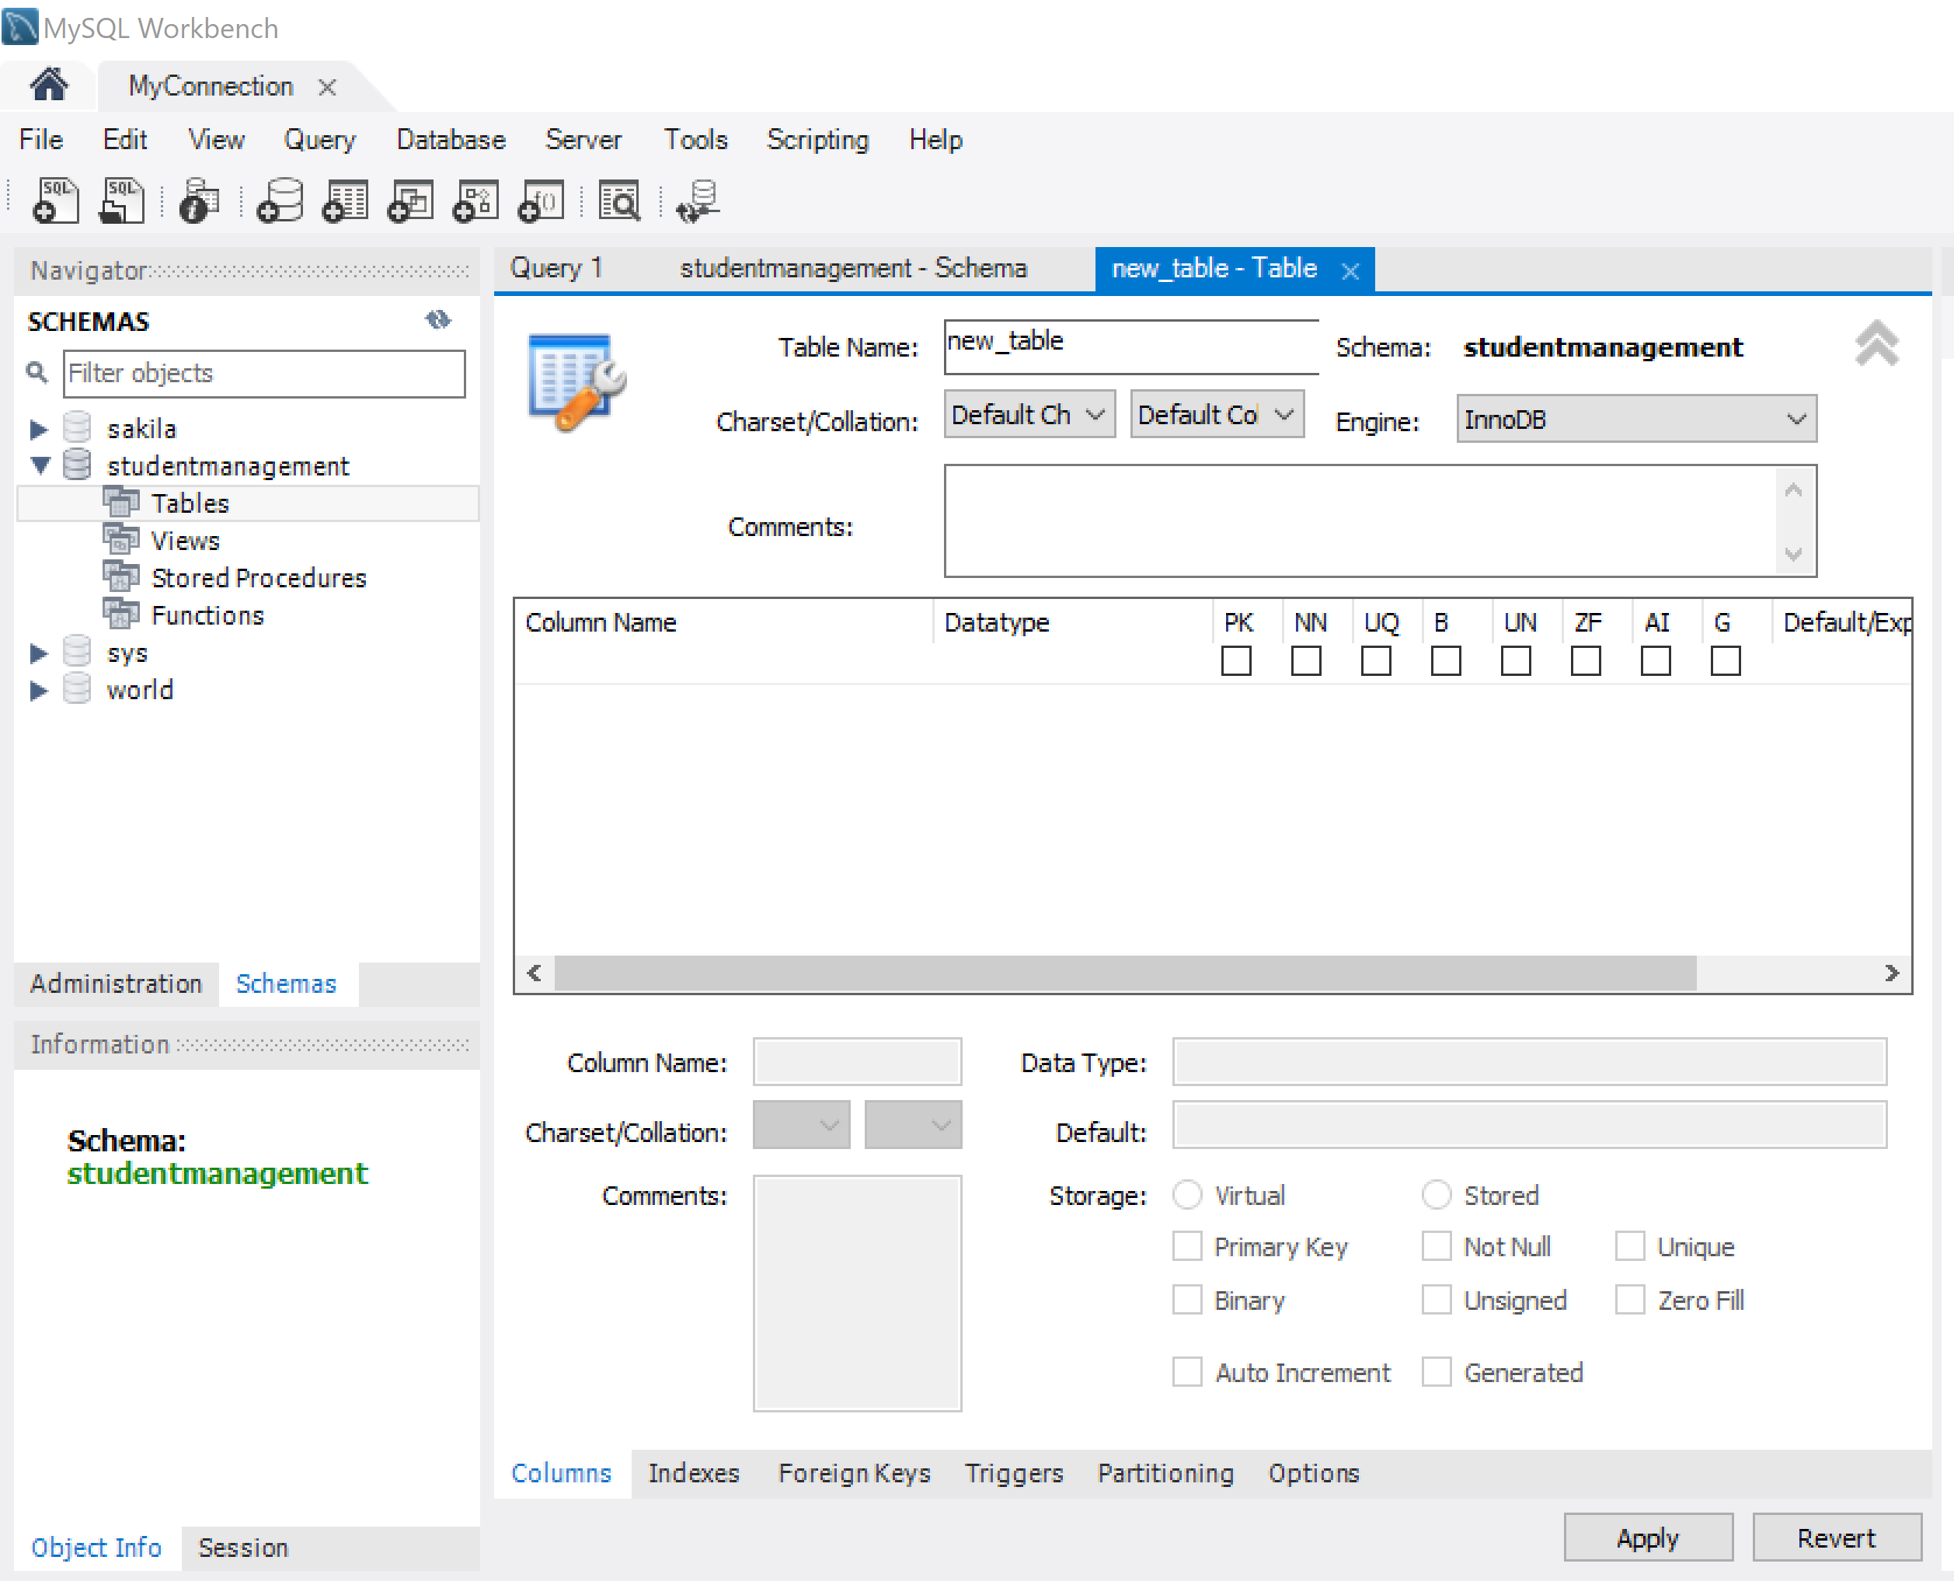

Slide 42
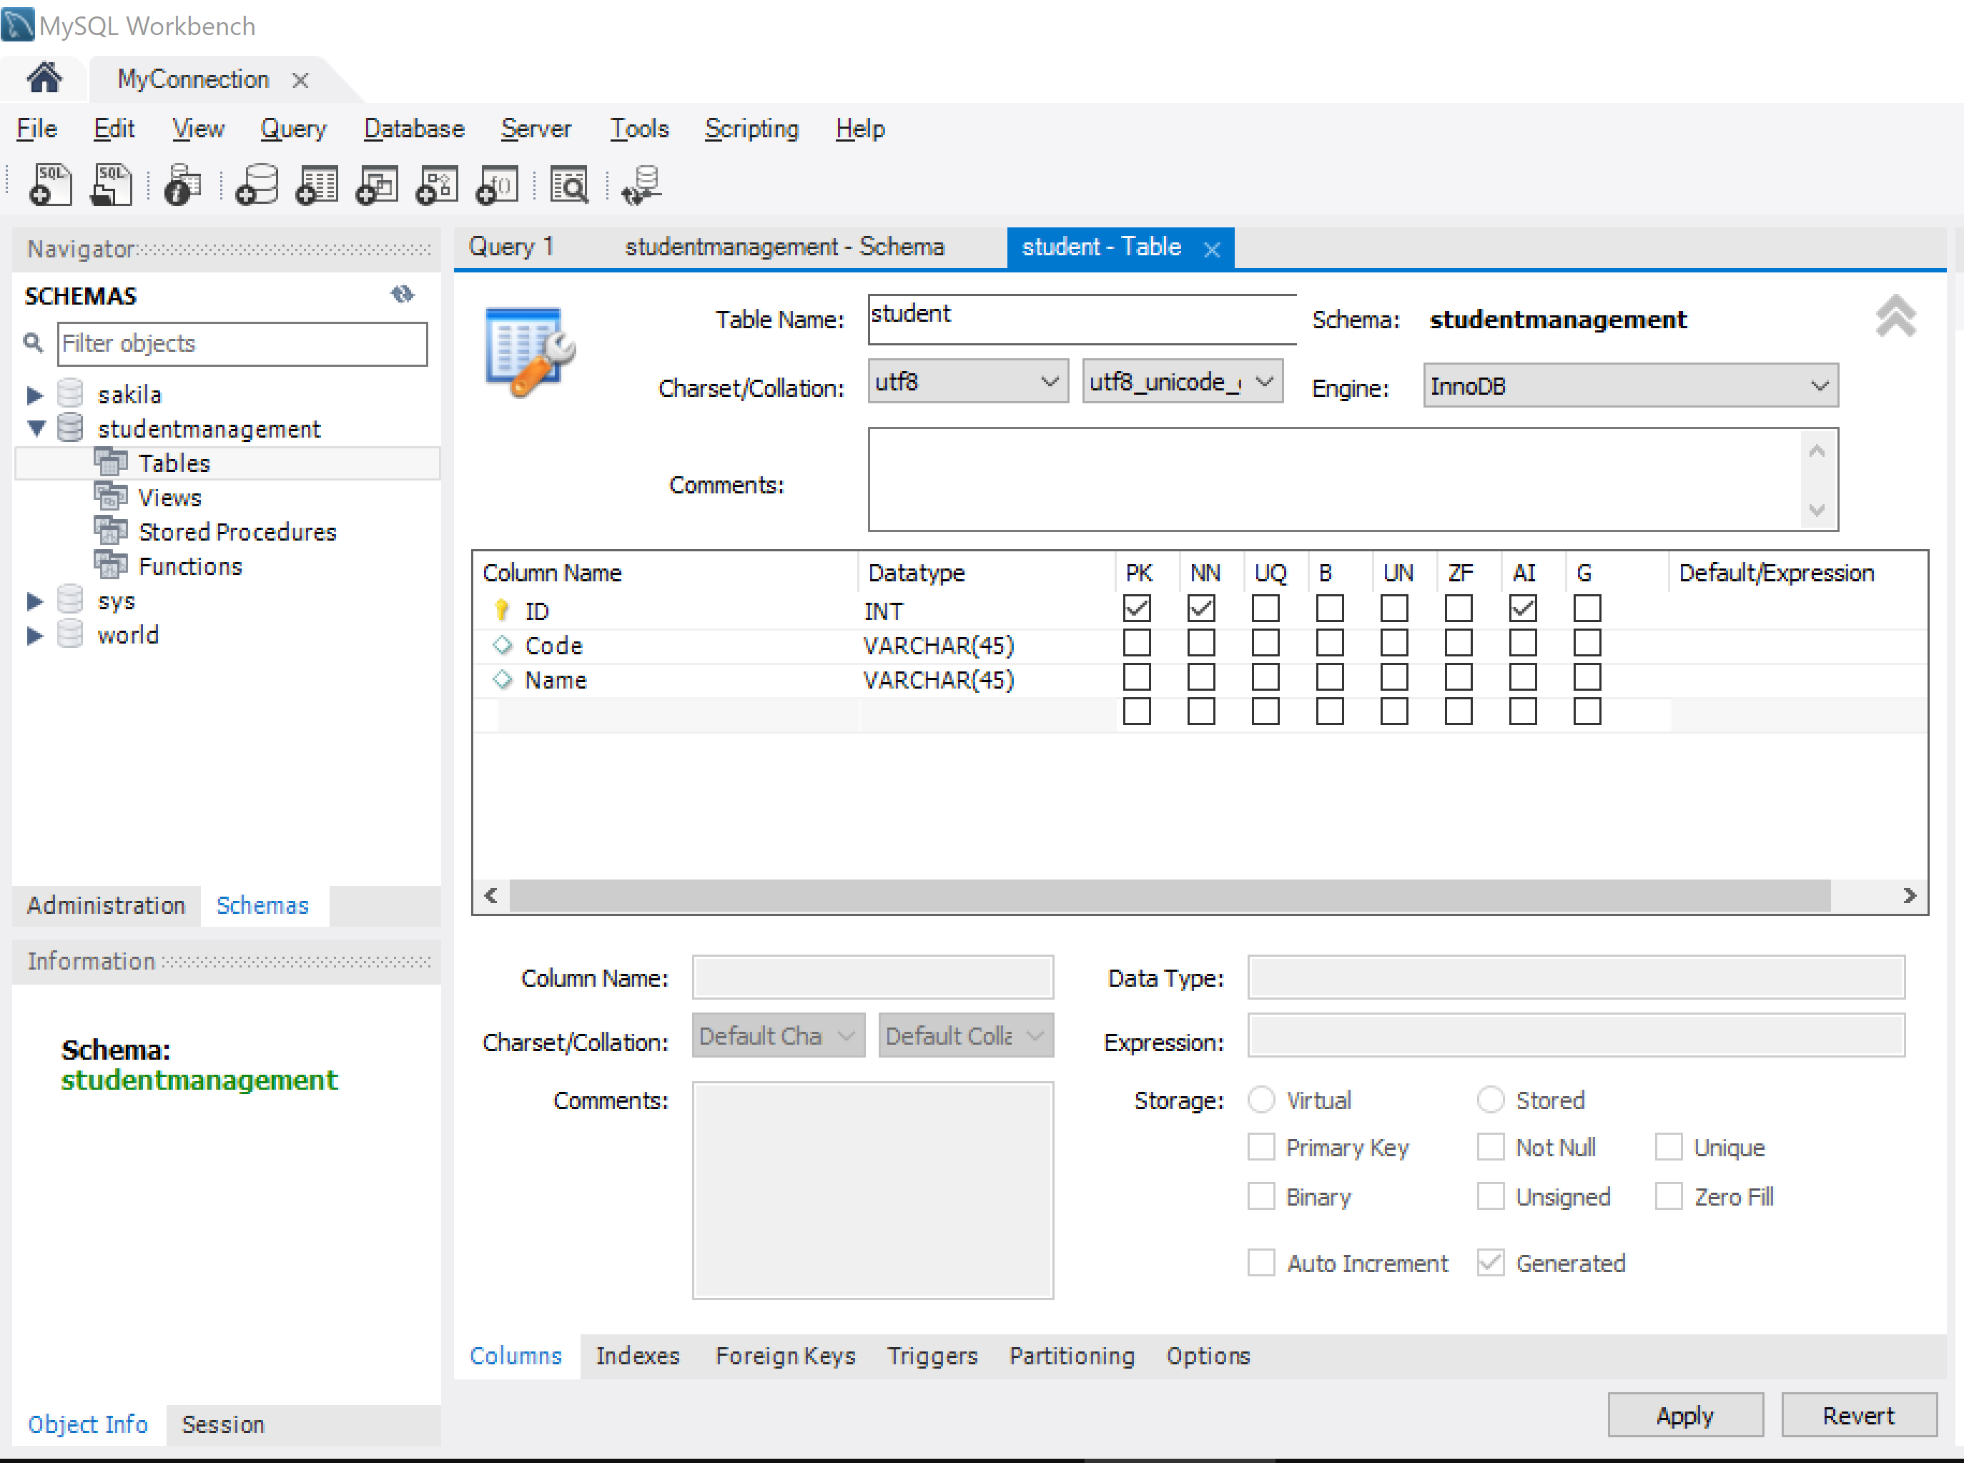

Slide 43
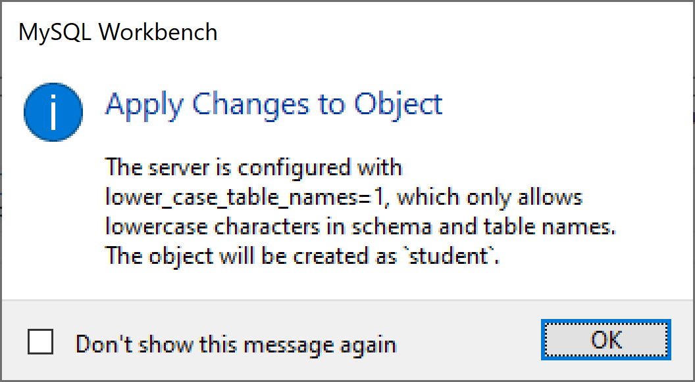

Slide 44
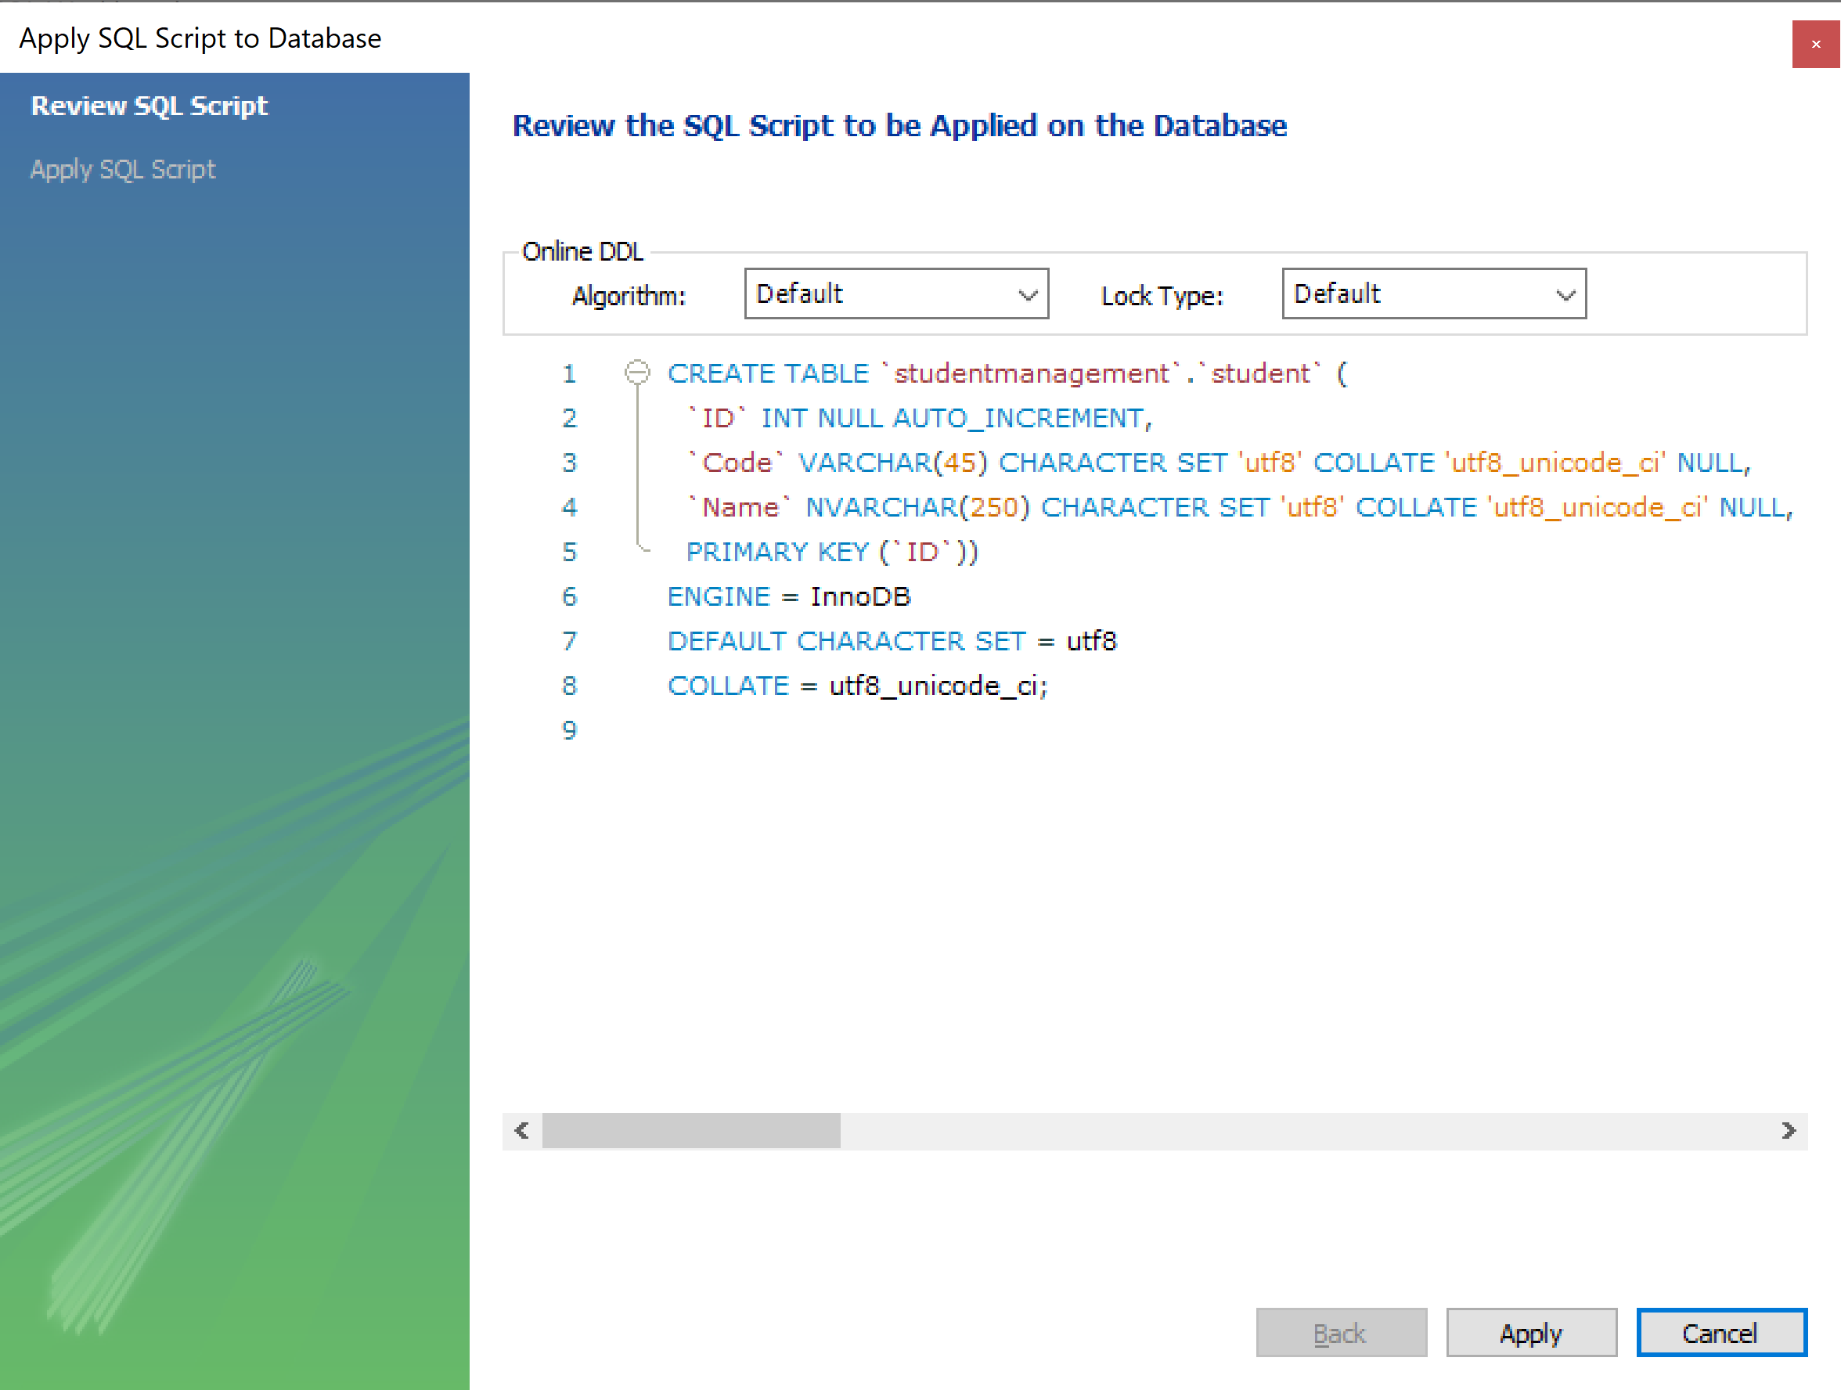

Slide 46
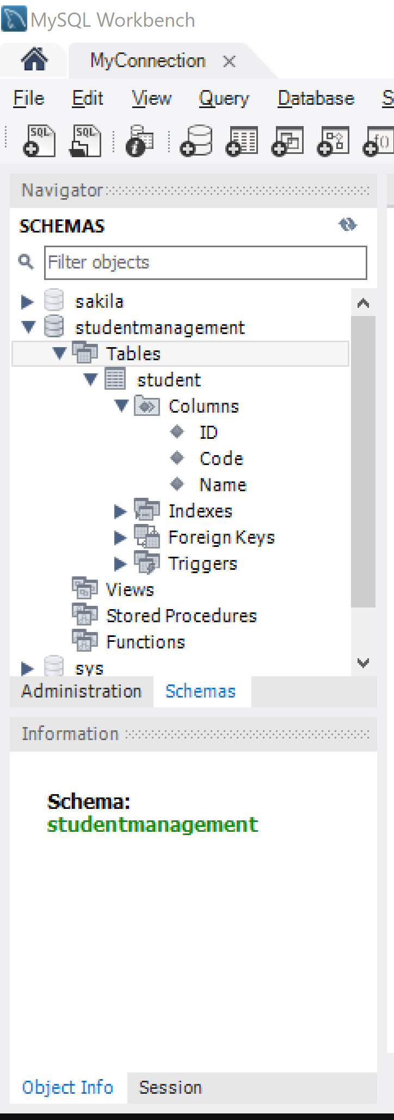

Slide 47
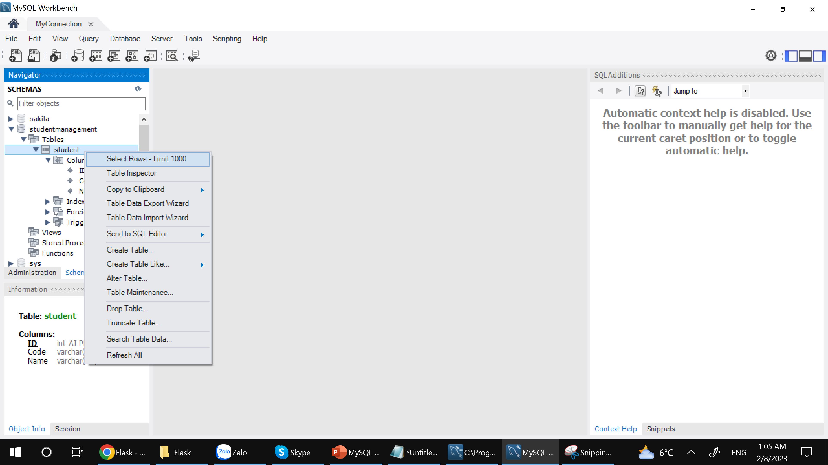

Slide 48
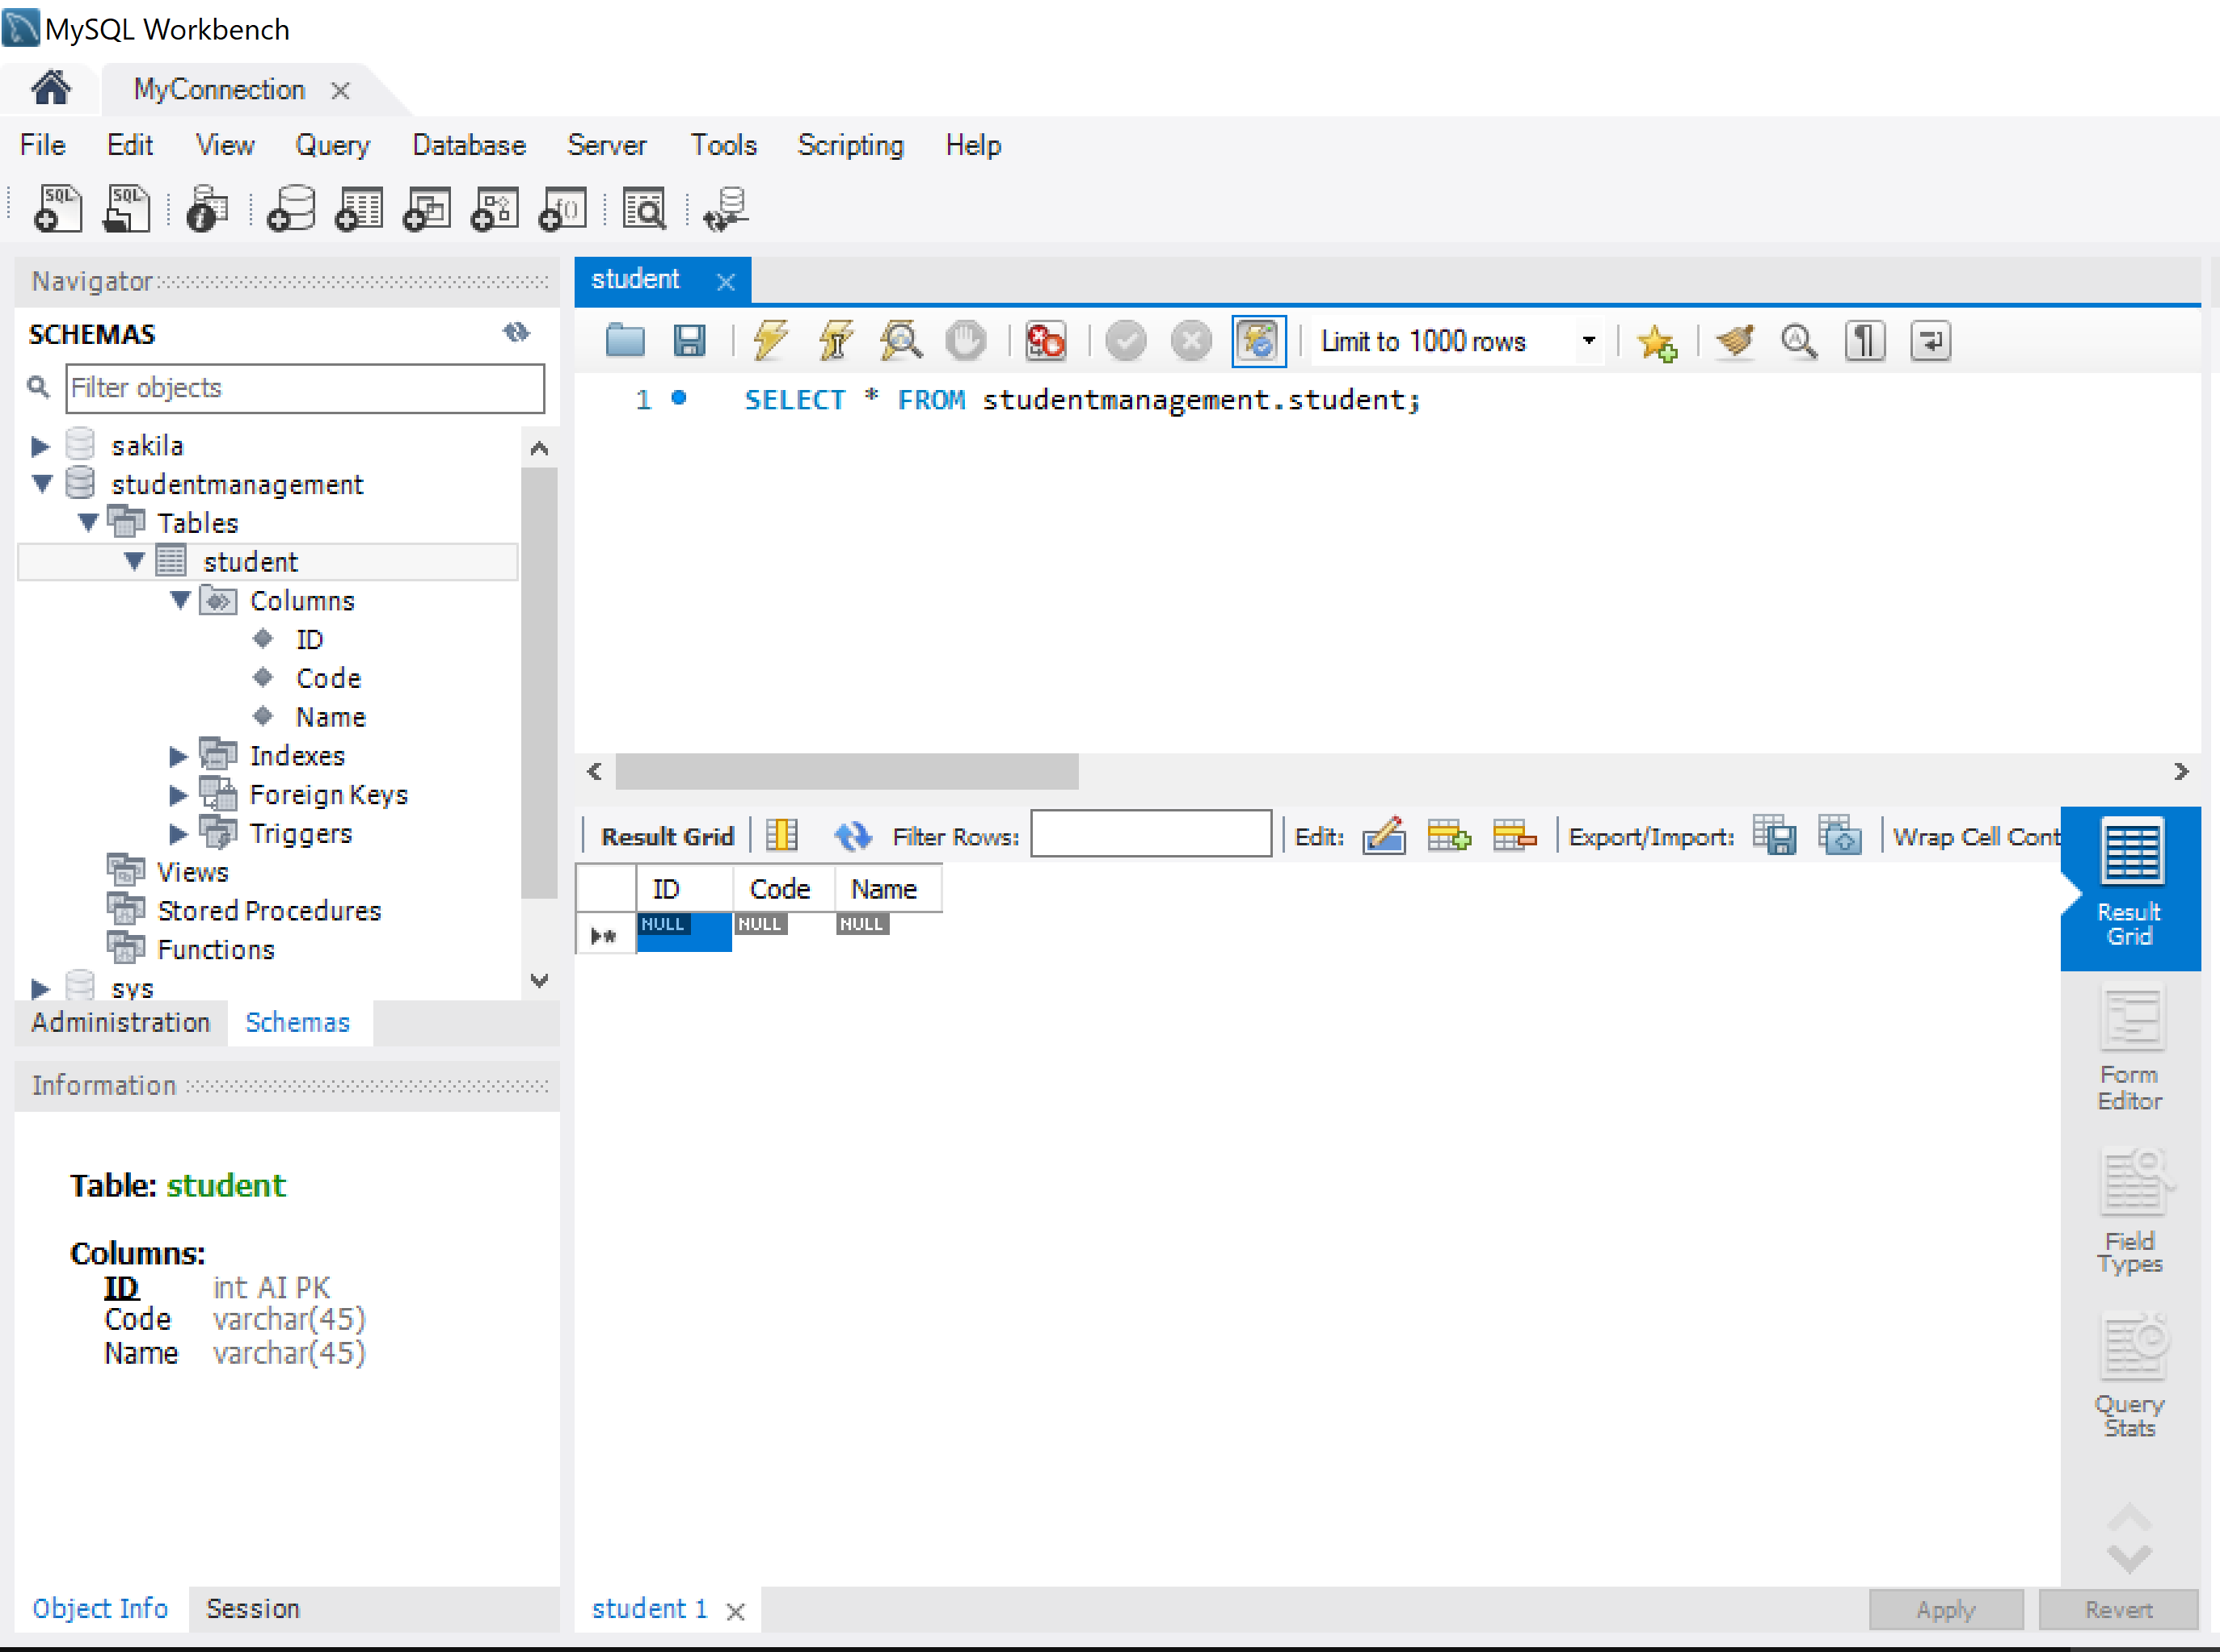

Slide 49
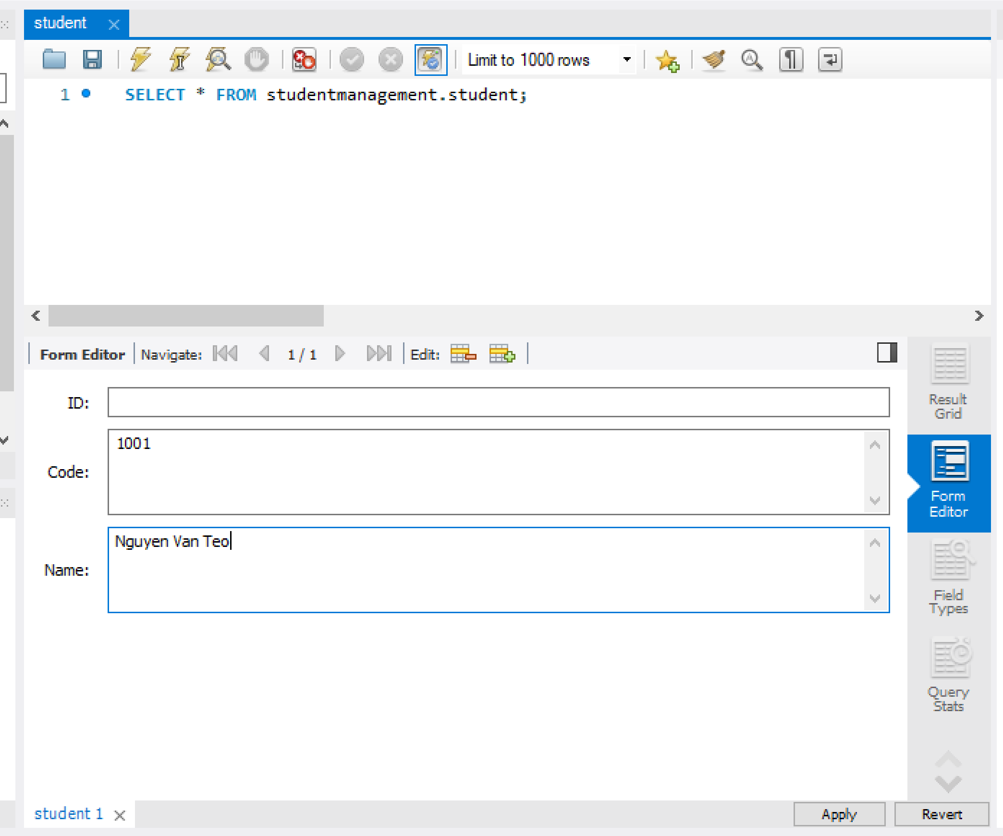

Slide 50
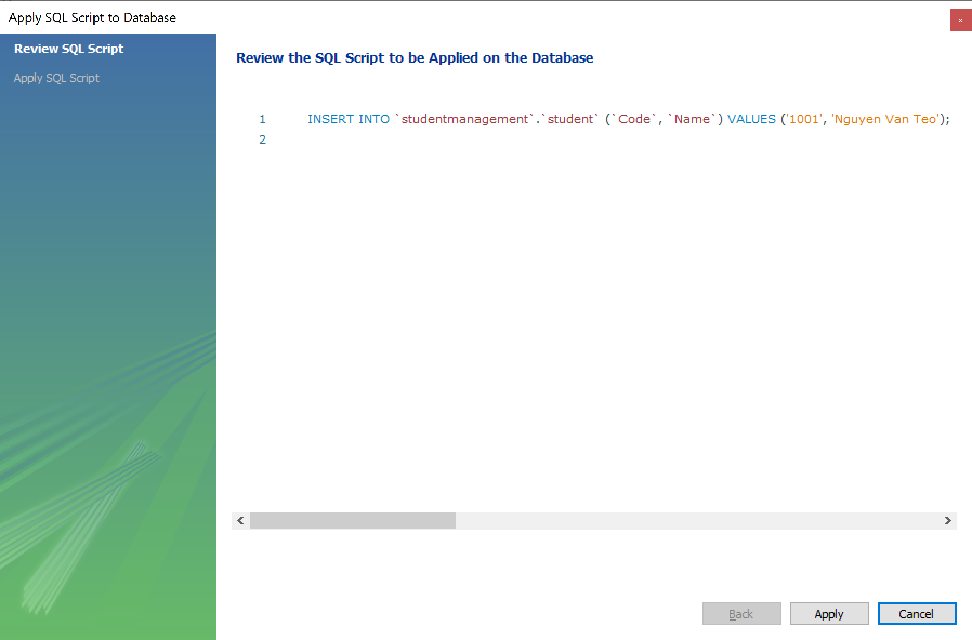

Slide 51
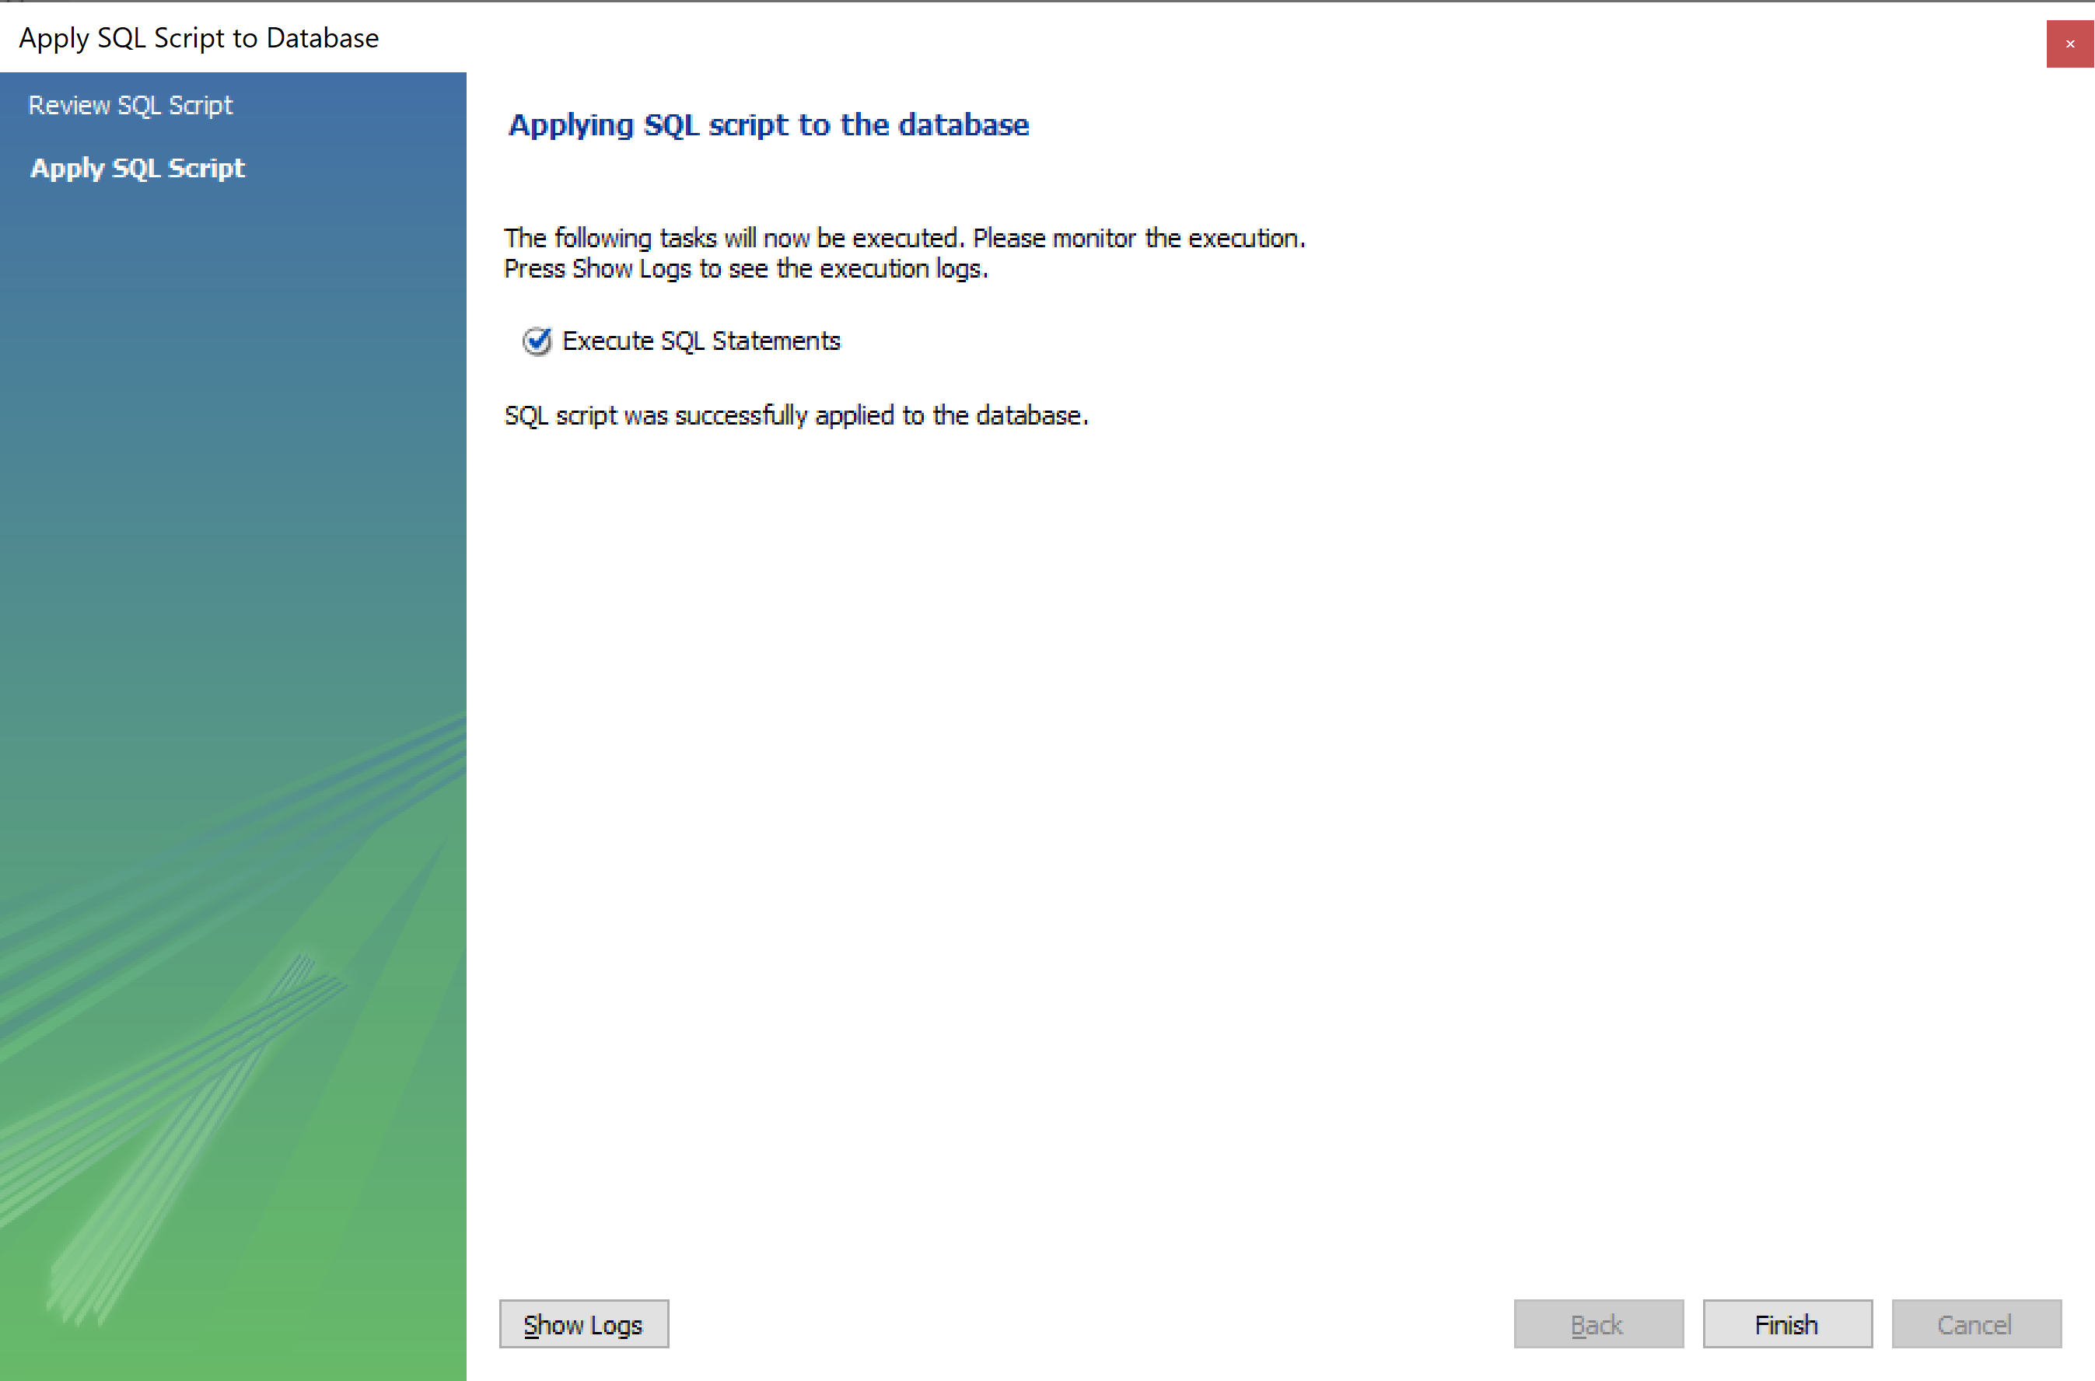

Slide 52
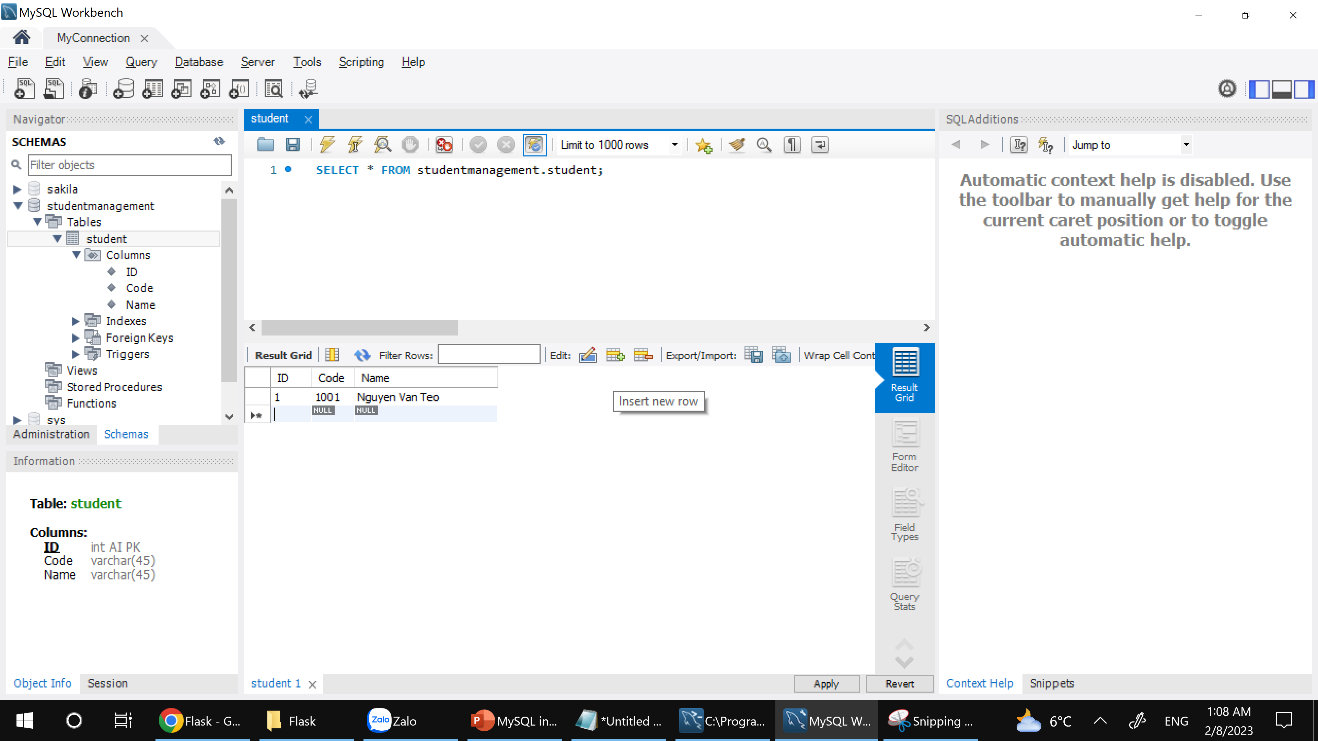

Slide 53
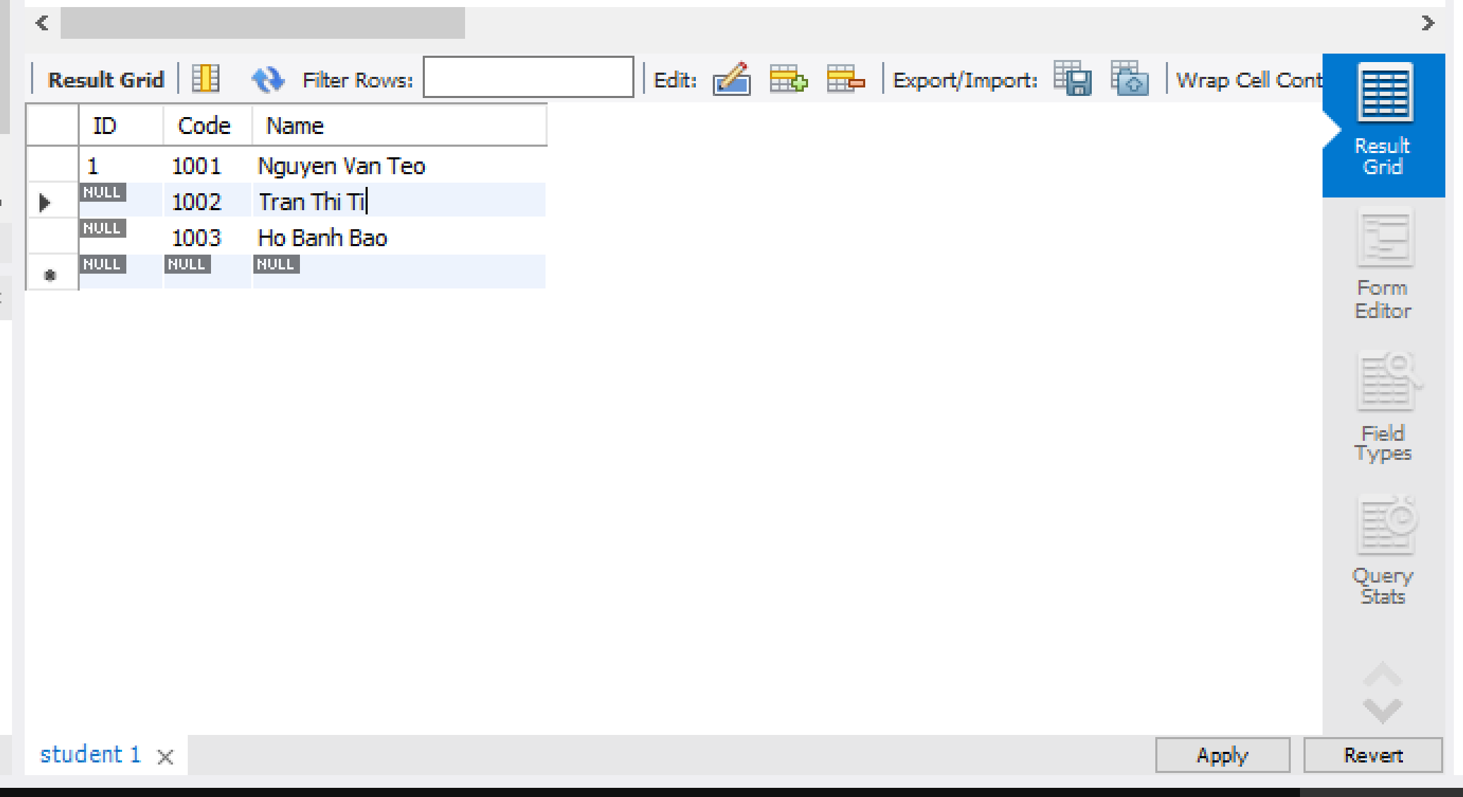

Slide 54


Slide 55


Slide 56
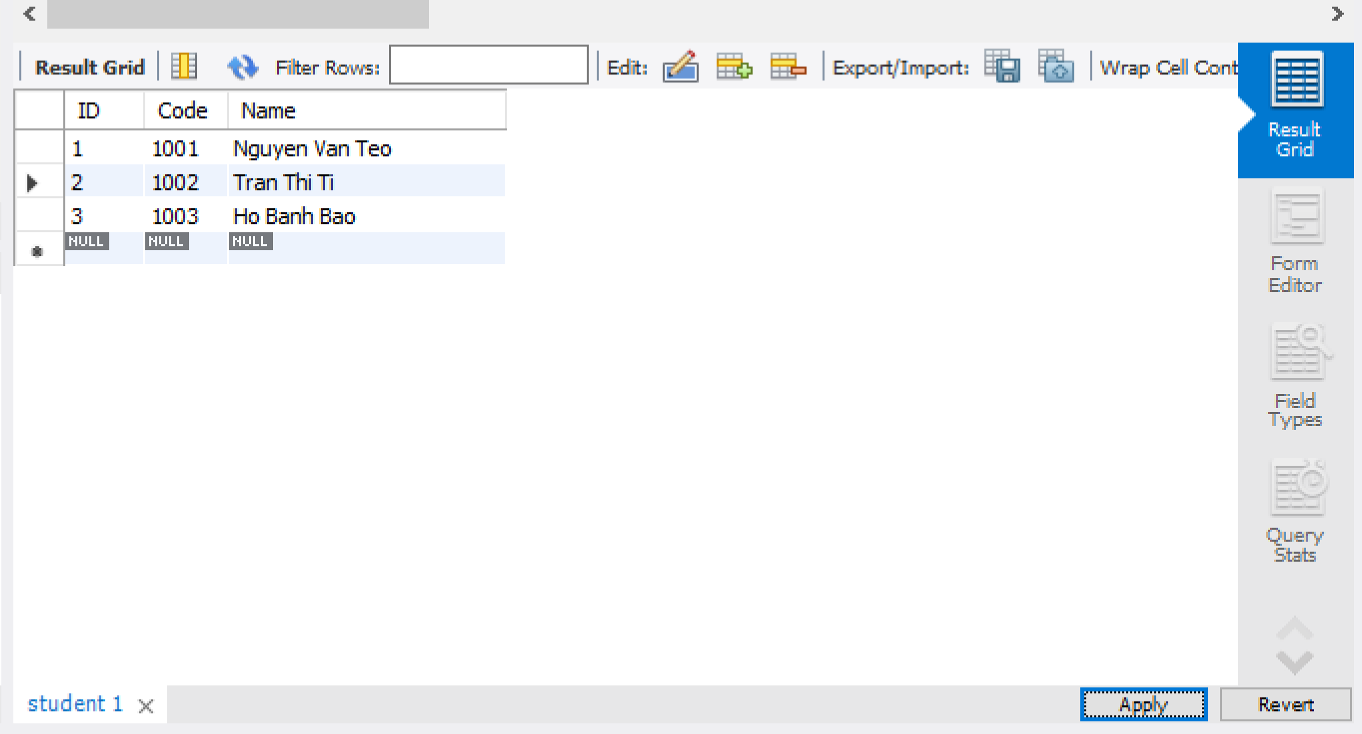

Slide 57
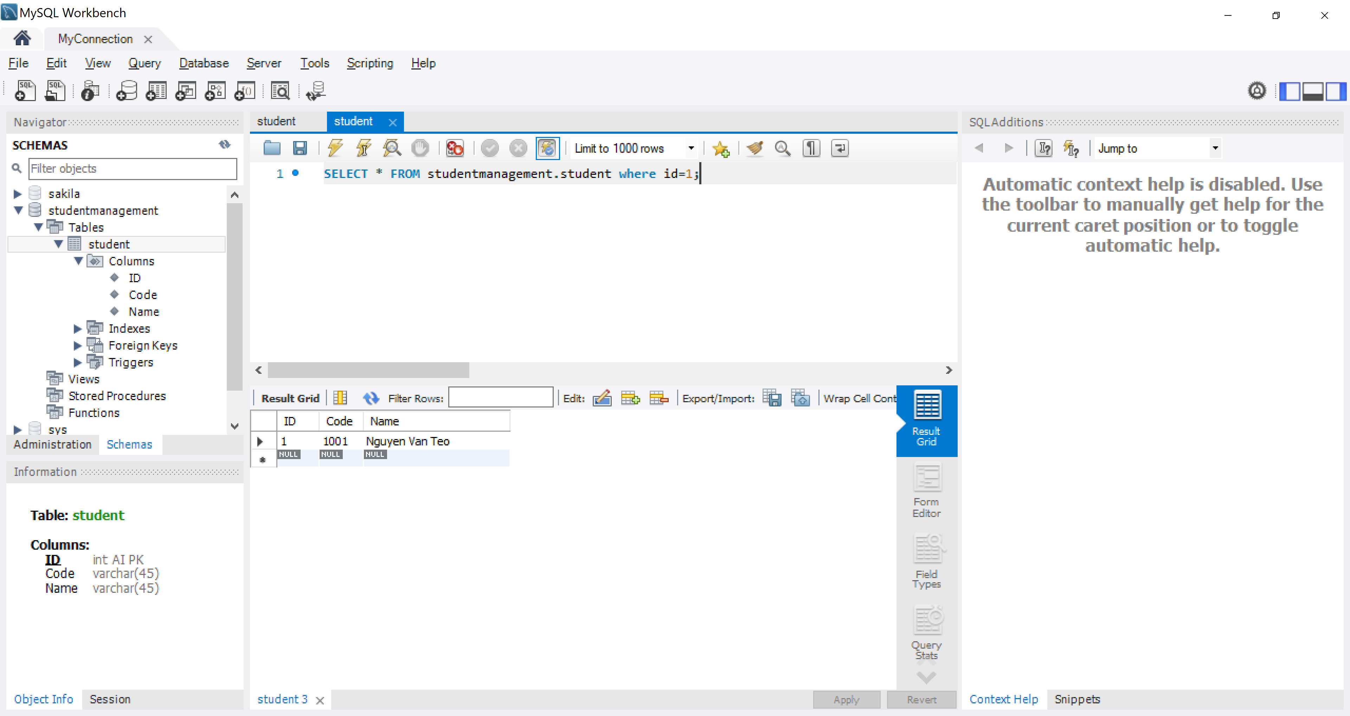

Slide 58
Select
Insert
Update
Delete

Slide 59
pip install flask
from flask import Flask, render_template
pip install flask-mysql
from flaskext.mysql import MySQL
pip install markupsafe==2.0.1

Slide 60
Select Student
from flask import Flask, render_template from flaskext.mysql import MySQL import mysql.connector app = Flask(__name__) try: mysql=MySQL() # MySQL configurations app.config['MYSQL_DATABASE_USER'] = 'root' app.config['MYSQL_DATABASE_PASSWORD'] = '@Obama123' app.config['MYSQL_DATABASE_DB'] = 'studentmanagement' app.config['MYSQL_DATABASE_HOST'] = 'localhost' mysql.init_app(app) conn = mysql.connect() print("connection is successful!") cursor = conn.cursor() cursor.execute("select * from student") data = cursor.fetchall() print("ID\tCode\tName") for item in data: print(item[0],"\t",item[1],"\t",item[2]) except mysql.connector.Error as e: print("Error = ",e) finally: conn.close() cursor.close() print("Mysql is closed")

Slide 61
Select Many Student
from flask import Flask, render_template from flaskext.mysql import MySQL import mysql.connector app = Flask(__name__) try: mysql=MySQL() # MySQL configurations app.config['MYSQL_DATABASE_USER'] = 'root' app.config['MYSQL_DATABASE_PASSWORD'] = '@Obama123' app.config['MYSQL_DATABASE_DB'] = 'studentmanagement' app.config['MYSQL_DATABASE_HOST'] = 'localhost' mysql.init_app(app) conn = mysql.connect() print("connection is successful!") cursor = conn.cursor() cursor.execute("select ID,Code,Name from student") data = cursor.fetchmany(4) print("ID\tCode\tName") for item in data: print(item[0],"\t",item[1],"\t",item[2]) except mysql.connector.Error as e: print("Error = ",e) finally: conn.close() cursor.close() print("Mysql is closed")

Slide 62
Select One Student
from flask import Flask, render_template from flaskext.mysql import MySQL import mysql.connector app = Flask(__name__) try: mysql=MySQL() # MySQL configurations app.config['MYSQL_DATABASE_USER'] = 'root' app.config['MYSQL_DATABASE_PASSWORD'] = '@Obama123' app.config['MYSQL_DATABASE_DB'] = 'studentmanagement' app.config['MYSQL_DATABASE_HOST'] = 'localhost' mysql.init_app(app) conn = mysql.connect() print("connection is successful!") cursor = conn.cursor() cursor.execute("select * from student") data = cursor.fetchone() print(data) except mysql.connector.Error as e: print("Error = ",e) finally: conn.close() cursor.close() print("Mysql is closed")

Slide 63
from flask import Flask, render_template from flaskext.mysql import MySQL import mysql.connector app = Flask(__name__) try: mysql=MySQL() # MySQL configurations app.config['MYSQL_DATABASE_USER'] = 'root' app.config['MYSQL_DATABASE_PASSWORD'] = '@Obama123' app.config['MYSQL_DATABASE_DB'] = 'studentmanagement' app.config['MYSQL_DATABASE_HOST'] = 'localhost' mysql.init_app(app) conn = mysql.connect() print("connection is successful!") cursor = conn.cursor() cursor.execute("select * from student order by name desc") data = cursor.fetchall() print("ID\tCode\tName") for item in data: print(item[0],"\t",item[1],"\t",item[2]) except mysql.connector.Error as e: print("Error = ",e) finally: conn.close() cursor.close() print("Mysql is closed")
Select Order Student

Slide 64
Select Where Student
from flask import Flask, render_template from flaskext.mysql import MySQL import mysql.connector app = Flask(__name__) try: mysql=MySQL() # MySQL configurations app.config['MYSQL_DATABASE_USER'] = 'root' app.config['MYSQL_DATABASE_PASSWORD'] = '@Obama123' app.config['MYSQL_DATABASE_DB'] = 'studentmanagement' app.config['MYSQL_DATABASE_HOST'] = 'localhost' mysql.init_app(app) conn = mysql.connect() print("connection is successful!") cursor = conn.cursor() cursor.execute("select * from student where Code='789'") data = cursor.fetchall() print("ID\tCode\tName") for item in data: print(item[0],"\t",item[1],"\t",item[2]) except mysql.connector.Error as e: print("Error = ",e) finally: conn.close() cursor.close() print("Mysql is closed")

Slide 65
Select Paging Student
from flask import Flask, render_template from flaskext.mysql import MySQL import mysql.connector app = Flask(__name__) try: mysql=MySQL() # MySQL configurations app.config['MYSQL_DATABASE_USER'] = 'root' app.config['MYSQL_DATABASE_PASSWORD'] = '@Obama123' app.config['MYSQL_DATABASE_DB'] = 'studentmanagement' app.config['MYSQL_DATABASE_HOST'] = 'localhost' mysql.init_app(app) conn = mysql.connect() print("connection is successful!") cursor = conn.cursor() cursor.execute("SELECT * FROM student LIMIT 4 OFFSET 3") data = cursor.fetchall() print("ID\tCode\tName") for item in data: print(item[0],"\t",item[1],"\t",item[2]) except mysql.connector.Error as e: print("Error = ",e) finally: conn.close() cursor.close() print("Mysql is closed")

Slide 66
Insert One Student
from flask import Flask, render_template from flaskext.mysql import MySQL import mysql.connector app = Flask(__name__) try: mysql=MySQL() # MySQL configurations app.config['MYSQL_DATABASE_USER'] = 'root' app.config['MYSQL_DATABASE_PASSWORD'] = '@Obama123' app.config['MYSQL_DATABASE_DB'] = 'studentmanagement' app.config['MYSQL_DATABASE_HOST'] = 'localhost' mysql.init_app(app) conn = mysql.connect() print("connection is successful!") cursor = conn.cursor() sql="insert into student (code,name) values (%s,%s)" val=("SV01","Thanh Tran") cursor.execute(sql,val) conn.commit() print(cursor.rowcount," record inserted") except mysql.connector.Error as e: print("Error = ",e) finally: conn.close() cursor.close() print("Mysql is closed")

Slide 67
from flask import Flask, render_template from flaskext.mysql import MySQL import mysql.connector app = Flask(__name__) try: mysql=MySQL() # MySQL configurations app.config['MYSQL_DATABASE_USER'] = 'root' app.config['MYSQL_DATABASE_PASSWORD'] = '@Obama123' app.config['MYSQL_DATABASE_DB'] = 'studentmanagement' app.config['MYSQL_DATABASE_HOST'] = 'localhost' mysql.init_app(app) conn = mysql.connect() print("connection is successful!") cursor = conn.cursor() sql="insert into student (code,name) values (%s,%s)" val=[("SV03","Pham Dieu"), ("SV04", "Thanh Tran"), ("SV05", "Man Nhi"), ] cursor.executemany(sql,val) conn.commit() print(cursor.rowcount," record inserted") except mysql.connector.Error as e: print("Error = ",e) finally: conn.close() cursor.close() print("Mysql is closed")
Insert Many Student

Slide 68
Update One Student
from flask import Flask, render_template from flaskext.mysql import MySQL import mysql.connector app = Flask(__name__) try: mysql=MySQL() # MySQL configurations app.config['MYSQL_DATABASE_USER'] = 'root' app.config['MYSQL_DATABASE_PASSWORD'] = '@Obama123' app.config['MYSQL_DATABASE_DB'] = 'studentmanagement' app.config['MYSQL_DATABASE_HOST'] = 'localhost' mysql.init_app(app) conn = mysql.connect() print("connection is successful!") cursor = conn.cursor() sql="update student set name='Pham Tang' where Code='456'" cursor.execute(sql) conn.commit() print(cursor.rowcount," record(s) affected") except mysql.connector.Error as e: print("Error = ",e) finally: conn.close() cursor.close() print("Mysql is closed")

Slide 69
Update SQL Injection Student
from flask import Flask, render_template from flaskext.mysql import MySQL import mysql.connector app = Flask(__name__) try: mysql=MySQL() # MySQL configurations app.config['MYSQL_DATABASE_USER'] = 'root' app.config['MYSQL_DATABASE_PASSWORD'] = '@Obama123' app.config['MYSQL_DATABASE_DB'] = 'studentmanagement' app.config['MYSQL_DATABASE_HOST'] = 'localhost' mysql.init_app(app) conn = mysql.connect() print("connection is successful!") cursor = conn.cursor() sql="update student set name=%s where Code=%s" val=('Pham Tang','789') cursor.execute(sql,val) conn.commit() print(cursor.rowcount," record(s) affected") except mysql.connector.Error as e: print("Error = ",e) finally: conn.close() cursor.close() print("Mysql is closed")

Slide 70
from flask import Flask, render_template from flaskext.mysql import MySQL import mysql.connector app = Flask(__name__) try: mysql=MySQL() # MySQL configurations app.config['MYSQL_DATABASE_USER'] = 'root' app.config['MYSQL_DATABASE_PASSWORD'] = '@Obama123' app.config['MYSQL_DATABASE_DB'] = 'studentmanagement' app.config['MYSQL_DATABASE_HOST'] = 'localhost' mysql.init_app(app) conn = mysql.connect() print("connection is successful!") cursor = conn.cursor() sql="DELETE from student where Code='456'" cursor.execute(sql) conn.commit() print(cursor.rowcount," record(s) affected") except mysql.connector.Error as e: print("Error = ",e) finally: conn.close() cursor.close() print("Mysql is closed")
Delete Student

Slide 71
from flask import Flask, render_template from flaskext.mysql import MySQL import mysql.connector app = Flask(__name__) try: mysql=MySQL() # MySQL configurations app.config['MYSQL_DATABASE_USER'] = 'root' app.config['MYSQL_DATABASE_PASSWORD'] = '@Obama123' app.config['MYSQL_DATABASE_DB'] = 'studentmanagement' app.config['MYSQL_DATABASE_HOST'] = 'localhost' mysql.init_app(app) conn = mysql.connect() print("connection is successful!") cursor = conn.cursor() sql="DELETE from student where Code=%s" val=("789") cursor.execute(sql,val) conn.commit() print(cursor.rowcount," record(s) affected") except mysql.connector.Error as e: print("Error = ",e) finally: conn.close() cursor.close() print("Mysql is closed")
Update SQL Injection Student

